Slide 1

SGA
FINANCIAL
WORKSHOP
Don Bennett, Financial Manager
bennettd@wpunj.edu Office: SC-321 Ext. 2481
Shellon Bristol, SGA Treasurer
bristols@student.wpunj.edu Office: SC-319 Ext. 3256

Slide 2

An overview of:
Information required, workflow and policies
New web-based system

Slide 3
What information do I need to gather for my event?
Event Information
-On-Campus Event
-Off-Campus Event
Financial Information
-Financial Requests
-Quote Information
-Pre-Contract Information
Supplemental Information
-Co-Sponsorship Information
FLYER-----ALL FINANCIAL REQUESTS REQUIRE A FLYER
-With the words “Funded by the Student Government Association”

Slide 4
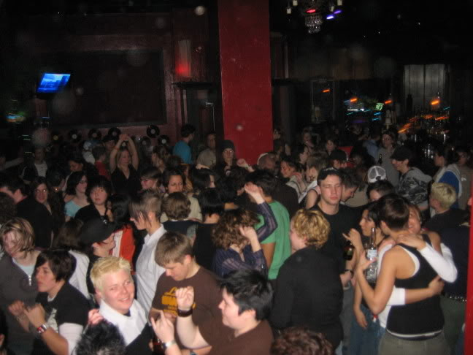
On Campus Event Information
`
Logistics of event:
-Who, What, When, and Where
Most events are free:
--Lectures, educational events, game nights, etc.
Events that require a ticket price:
--Primarily large scale entertainment events (Parties, Comedy Shows)

Slide 5

Off Campus Event Information
Logistics of event
Who, What, When, and Where
Pickup time/location
Transportation
Bus Service Required
Tickets
Required for all off campus trips
Students get a discount rate and first priority over guests
Advisor
Required-One advisor per bus

Slide 6

Financial Request Information
-Each item you are requesting funds for requires its own financial request
-Vendor information required
-Common vendors are loaded into the system
-Other vendors must be input on the request

Slide 7
Quote Information
-Supports financial request for general services or items over $350
-Three (3) quotes are required to be submitted
Examples include:
-Bus Service
-Stage/Sound/Lighting
-Quote Information is completed on-line, however 3 paper quotes (email, fax, letter) must be submitted to SGA

Slide 8

Pre-Contract Information
`
-Supports Financial Request for performers
-Complete when requesting funding for:
-Lectures/Speakers
-Bands
-DJs
-Other vendors performing on campus

Slide 9

Co-Sponsorship Information
-Agreement between co-sponsoring organizations
-Each organization will list their contribution to the event

Slide 10

Food for events
All food for events will be supplied by Sodexo, our on campus catering service
To request food for an event, meet with Sodexo staff (located in Hosp. Svcs.) and fill out a food service quote form
Submit an online financial request and food service quote form to SGA

Slide 11
Planning ahead is key………
Greek Senate/SAPB must approve all financial requests
Events costing under $500 must be approved 2 weeks before the event
Events costing $500-$5,000 must be approved 3 weeks before the event
Events costing over $5,000 must be approved 5 weeks before the event

Slide 12
Club Request Approval Board
SGA Finance Committee
SGA Finance Committee must approve all club financial requests
Finance Committee meets every Tuesday (common hour) to hear financial requests
In order to be heard by Finance Committee, all event forms and financial requests must be approved by Club President/Treasurer and advisor by the Wednesday prior to the Finance meeting you will to attend
Events costing under $500 must be approved by Finance 2 weeks before your event
Events costing $500-$5,000 must be approved by Finance 3 weeks before your event
Events costing over $5,000 must be approved by Finance 5 weeks before your event (Needs SGA Legislature approval as well)

Slide 13
February
1 | 2 | 3 | 4 | 5 | 6 | 7
8 | 9 | 10 | 11 | 12 | 13 | 14
15 | 16 | 17 | 18 | 19 | 20 | 21
22 | 23 | 24 | 25 | 26 | 27 | 28

Slide 14
Greek Senate & SAPB
On-Line Purchasing Process
Request approved by Pres/Treas.
Request approved by CASL
Request approved by SGA Financial Manager
P.O. Issued
Request approved by SGA Treasurer
Financial request submitted

Slide 15
SGA Clubs
On-Line Purchasing Process
Meet with CASL for Approval
Request approved by SGA Financial Manager
P.O. Issued
Attend Finance Committee
Financial request submitted by Pres/Treas.
Meet with Advisor for Approval

Slide 16

My funds are approved and I have my P.O. numbers now what……
-FOLLOW-UP: Contact vendors with P.O. numbers, confirm date and services provided.
-MAJOR REQUESTS: Vendors, speakers, businesses, food service and WPU charges will be paid by check.
-Some vendors are paid day of event
-All WPU services are paid after event
-MINOR REQUESTS: Supplies, giveaways, decorations can be paid via the SGA credit card.
-Bring P.O. number to CASL office and request to sign out SGA credit card
-Purchase items and return card and receipts to CASL

Slide 17


Club O.P. Funds
O.P. funds are funds raised independent of SGA funding (proceeds from a bake sale, donation, etc).
O.P. funds may be accessed by the Club President/Treasurer by submitting an online request.
The timing requirements for requesting these funds is the same as all other funding requests (Under $500-request submitted 2 weeks before event).

Slide 18
Other information & tips
Campus Activities will assist you in the planning process
Plan ahead…………….remember 2, 3, and 5 weeks for approval
Students cannot enter into any formal agreements (signing contracts,
agreements, invoices) when using SGA funds
Clubs are not permitted to have off-campus bank accounts (You have an OP account)
-$$$$- Deposits -$$$$- Ticket sales, fundraising proceeds should be deposited with Financial Manager/SGA Bookkeeper the next business day
Please submit any contracts, invoices, or other financial information to SGA Financial Manager
If ordering items on-line, please use the SGA office as the mailing address
Please refer to the SGA Financial Guidelines for further information
The guidelines can be found on the SGA website : www.wpunj.edu/sga
Violations of the guidelines can result in financial sanction, suspension, or de-chartering……..we don’t want that!

Slide 19
SGA Financial System Sign-Up
-Website: http://wpunj.collegiatelink.net
1. Upper right hand corner, click on “LOGIN”
2. Enter your WPU User ID and WPU Password and click “LOGIN”
3. Logout
-In 24-48 hours login again and you will have access to your organization under “My Current Involvement”
-Click on organization
-Select “Finance” drop down and Submit Funding/Purchase Request
-Monitor your request “stage” (Advisor, CASL, SGA Treasurer)
-Final approval (Stage 5)=Purchase Order # on-line with your request (No more SGA mailbox or contacting Financial Manager)
-Please share this sign-up information with your advisor

