Slide 1
SGA Conference
October 25, 2014
Chicago, IL

Slide 2
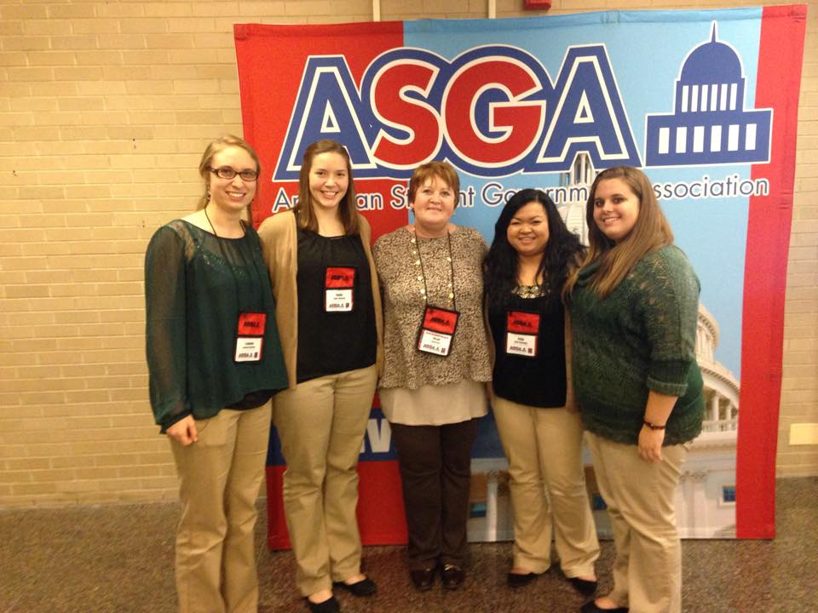
ASGA
What is this organization?
The American Student Government Association is the professional organization that serves and supports collegiate SGs nationwide.
Connect.
Commit.
Serve.

Slide 3
Importance of New Events and Updating Traditions
It is great to have events and traditions, but we need to constantly see how we can improve them and make them better for all students.
Sometimes we keep outdated traditions that have lost their appeal. We can fix this issue by adding to the event or by deleting a section and filling it with something new and spontaneous.
The little things matter such as changing location, working with other clubs for fresh ideas, and just trying new things. It’s okay if event don’t work, your club will learn from it.
It's important to always be thinking of how you can create new traditions on campus. It not only brings the campus community together, but it allows for you to think back and say, “Wow, I made this happen!"
We need to create events that would be beneficial to the students. We have many commuters and we need to research how we can create events they are able to go to.

Slide 4
President/Vice President Roundtable Commuter Involvement
Target class times
Quick surveys
More convenient event times
More effective advertising
Commuter Appreciation Week
Gas card giveaways
Commuter “Happy Hours → free food, giveaways
Family-friendly event on the weekend

Slide 5
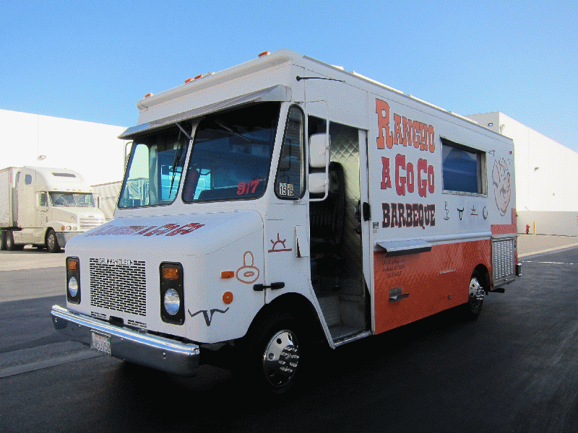
New Ideas:
Cool events we learned about that would be nice to bring to the Mount are:
-Car services -Bicycle Checkout
-Oktober Fest -Munchie Truck/Cart
-Inspirational Events

Slide 6
Wait a minute…
5 Keys to Effective Minutes
1. Thoroughness
2. Impartiality
3. Proper Formatting
4. Orderly
5. Historically consistent

Slide 7
Dirty Fighting Techniques
Avoiding Responsibility
Listing Injustices
Timing
Mind-reading
Brown Bagging
Leaving
Personalizing
Crucializing
Not Listening - Dominating
Playing the Martyr
All of these techniques avoid solving the actual problem.

Slide 8
Handling Conflict and Drama
You can do this by simply asking the person you have an issue with, "What did you mean by this comment?" or, "Why did you react that way?" to get their side of the issue first.
Then explain to them how it made you feel.
Talk to them and come up with ways you can fix the issue or make it so it doesn't happen again.
Not addressing problems as a person and as a leader is being lazy.
As leaders of organizations, we signed up for conflict and it isn’t simple.
The roles we play in our organizations and the tasks we work to accomplish are too important to be left to chance and not address though.
Notes:
Thumb-war activity

Slide 9
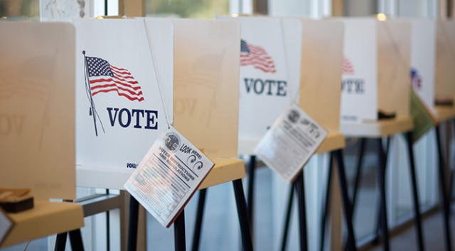
Steps to a Super Student Government Top 6 Election Tips
Recruit more candidates – just ask!
Use online voting
Add more poll locations
Make polls a spectacle
Add voting days
Change election days
Need to allow new officers time to transition

Slide 10
Delegation
Define
Engage
Listen
Explain
Give boundaries
Agree on deadlines
Train as needed
Ease off

Slide 11
Power of Ongoing Regard-Why is this important?
Most of us have all probably been in situations where we felt unappreciated or the time and effort we put into a project went unnoticed.
Recognizing others for their hard work and effort though makes them feel appreciated and that what they are doing is important.
It acknowledges our partnerships and that we are all jointly committed to the success of our organization and University.

Slide 12
What Makes Ongoing Regard Unique
It shows your appreciation and admiration!
Be direct, specific, and non-attributive.
Offers precise information about one’s significance.
Speaks directly to the other person.
Should reveal something about yourself.
More powerful.

Slide 13
“Leadership isn’t about changing the world – it’s about lollipop moments.”

Slide 14
