Slide 1

Student organization Advisor Training
Notes:
Introductions-Kyle & Jake

Slide 2
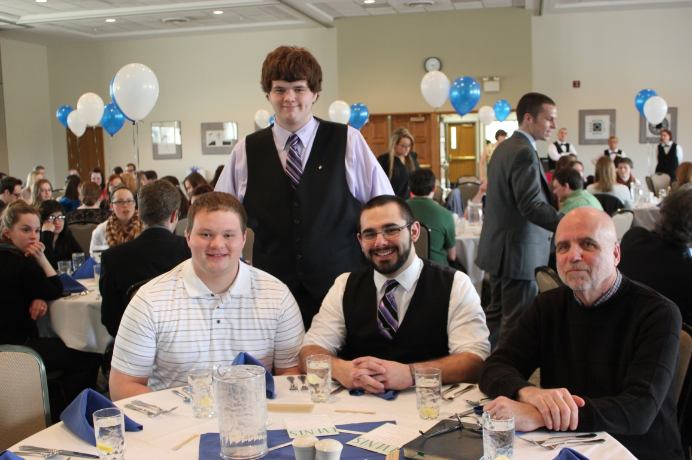
Advisor Training Overview
-Office of Student Activities
-Your Role
-Paperwork
-Group Dynamics
-What do they already know?
-Advisor Resources
-Questions
Notes:
Jake

Slide 3
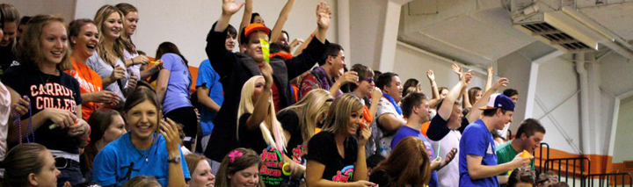
Learning OUtcomes
Know and understand the responsibilities of being an advisor
How to be a successful/engaged advisor
Know what advisors’ organizations are going through and how to best serve
Who to go to for answers
Have face to face time with other advisors on campus
Notes:
Jake
-Responsibilities-Know what you signed up for! Sometimes students don’t always paint the full picture.
-How to be successful/engaged-Provide you some tools to engage with your Org
-To provide a snapshot of what Orgs are required to do/what we ask of them
-The who’s who of Student Activities
-Spend some time with one another-know who other advisors are-Last spring’s thank you helped show the long list of people who put in a lot of work!

Slide 4
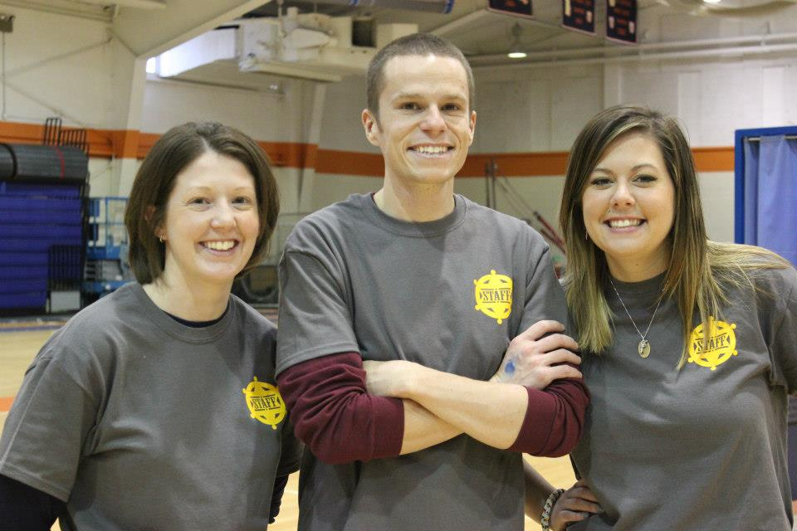
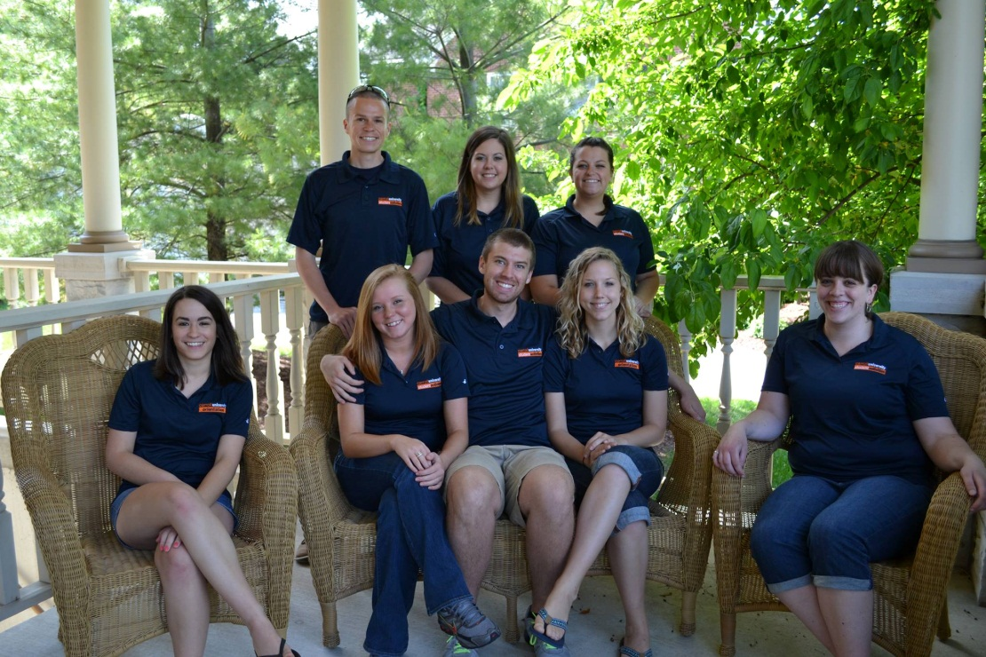
Who are We?
Student Activities
Elizabeth Brzeski – Sr. Dir. of Student Affairs
Jake Eisch – Assoc. Dir. of Student Activities
Katy Launius – Asst. Dir. Of Student Activities
Student Activities Workers
  This is just a small handful of us!
  We can pretty much answer any
  questions you may have
Email: carrolluniversitysa@gmail.com
Phone: 262.650.4805
Notes:
Kyle

Slide 5








General Office of Student Activities Information
Responsibilities
  Student Organizations
  Greek Life
  Orientation
  Travel Series
  Alternative Spring Break
  Leadership
  CU @ Night
Available to provide partnership opportunities
Notes:
Kyle

Slide 6
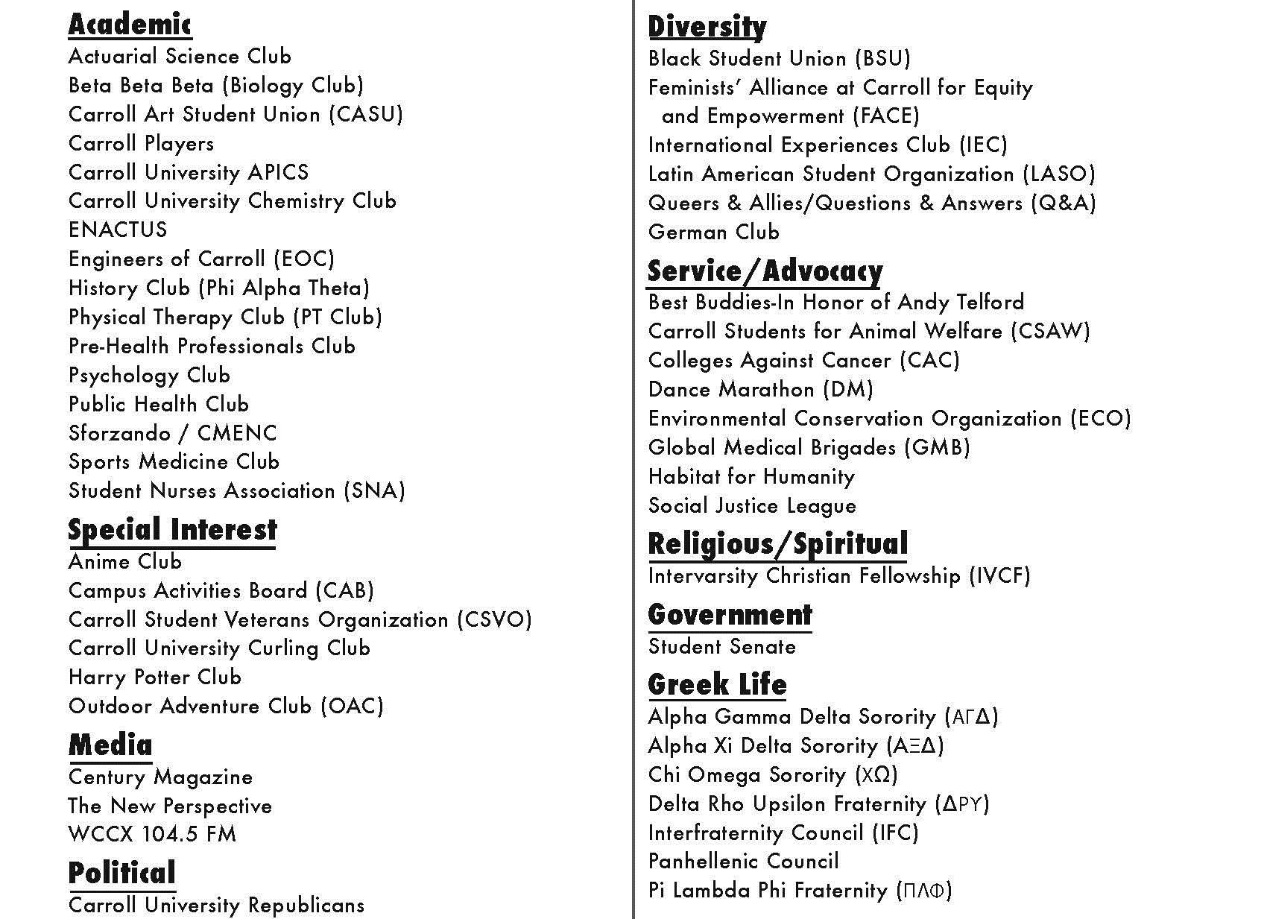
Student Organizations
Link to handbook
  Or variety of pages on LMS (if separated)
Notes:
Kyle

Slide 7
Responsibilities
Take an active role in advising the student organization.
Know the purpose of the organization
Meet with the organization president and executive board on a regular basis
Be informed of activities sponsored by the organization.
Know the organization’s process for recruitment.
Offer guidance to the organization on goal setting, organization management, program planning, problem solving, budget management and group evaluation.
Refer questions concerning the Student handbook to the appropriate department and where the case is not clearly discernible, to the Office of Student Activities.
Report immediately to the Office of Student Activities any actions that may or will violate University policy (hazing, unethical use of funds, alcohol consumption on a trip etc.)
Notes:
Jake (First 4) Kyle (Last 4)
-Not only do we want advisors to have there name on a piece of paper, but we want you to be a part of the organization. Both the organization and you should be benefiting throught this relationship.
-This means that you should essentially be a member and understand what the groups goals are. Read up on the group. This means look at the constitution and what their goals are for the year.
Have a goal of meeting with presidents once a month and the executive board twice a semester. Having an active role also leads into meeting with the presidents and the executive board as a whole. Executive boards should have regular meetings, so join them at one.
Each organization is required to do one all campus event along with a service project each semester. Serve as a resource for them and help them succeed!
Where does your organization do its recruitment? Does it host an information event? Student Activities provides two opportunities for this. The student involvement fair in the fall semester and the student org fair during spring fling. Ask your organization how they plan on getting more members and plan on keeping them.

Slide 8
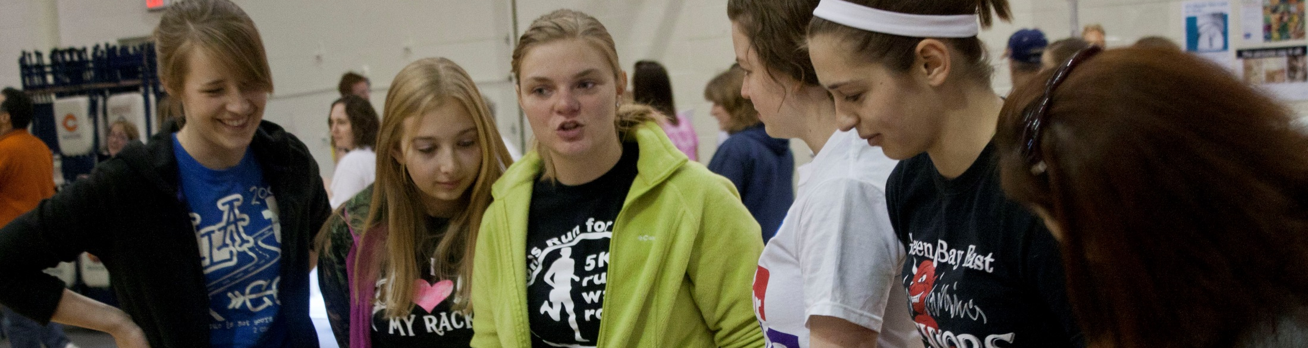
Advisor-Organization Agreement
Link to handout on portal
Guided conversation with the organization (president or executive board)
Helps initiate advisor/advisee relationship
Understand the culture shift of the group from year to year
Not a requirement but instead a facilitation tool
Notes:
Kyle-Speak of own experience and the value of having conversation with Advisor

Slide 9
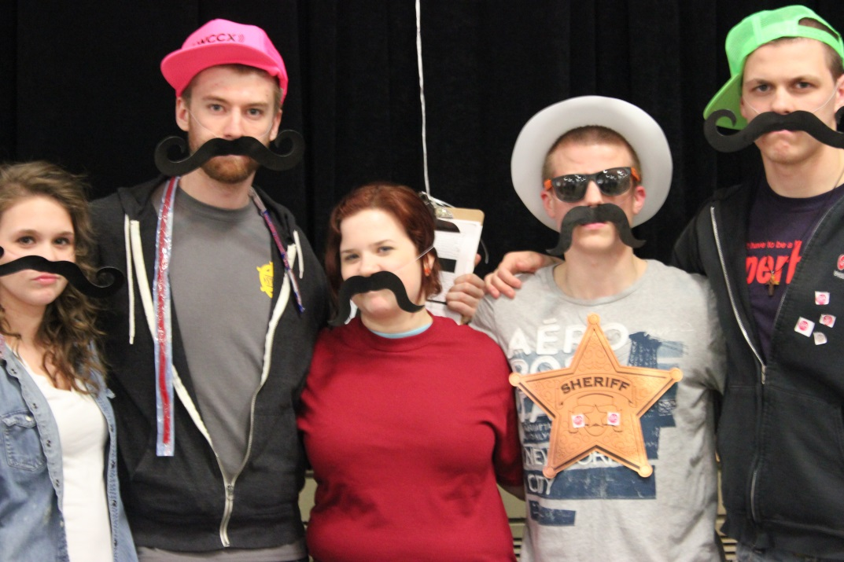
Paperwork
Finance Documents
  Requests for Payments
  Budgets
Contracts
  Work 15 business days ahead of when you want to bring someone to campus
    Paperwork (15 business days)
    Everything else (Much more in advance)
Room Reservations
  Fees & Astra
Event/Semesterly Documents
  Volunteer/Service Form
  Campus Event Form
  End of Semester/Event Forms
Notes:
Jake-
Finance- Request for payments (30 days, original reciepts, prize log) Budgets (MUST DO THESE!)
Contracts- (Find on Portal-MUST DO THESE-Plan ahead!)
Room Reservations- (This year will be a learning year-be hands on with Events and Student Activities) We should be able to answer questions, but we’re learning as well! Plan accordingly and communicate accordingly. Positive Attitude about events fees!
Event Docs- Help us know what is going on with the organizations in a timely manner and to hold groups accountable. We obviously want organizations that are going to be active and providing opportunities to students on campus. That’s what their money is going toward! Also-We’re going GREEN! Online forms for all!

Slide 10
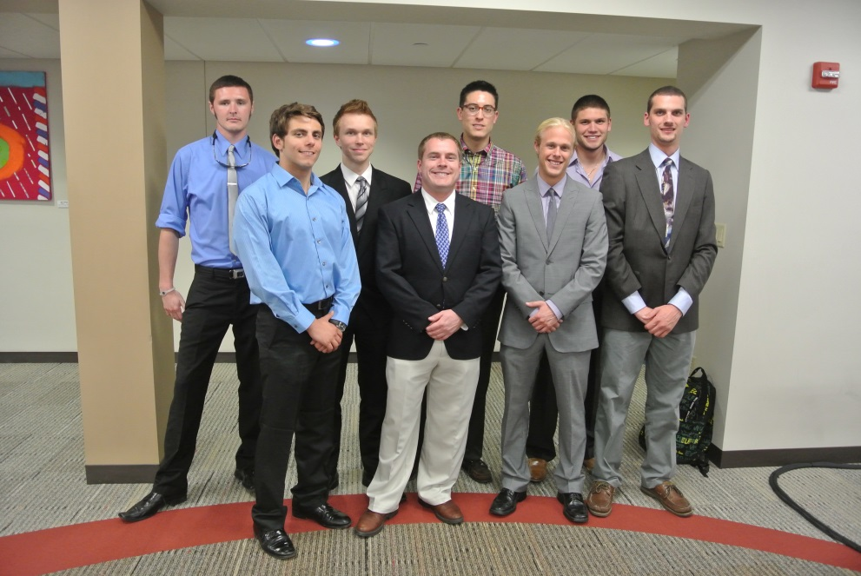
Expectations of Student Organizations
-Respectful of Advisors
-Familiar with:
  Policies and Procedures
  Booking rooms
  Planning an event
  Financial Policies (Student Senate)
-One service project/semester
-One all campus event/semester
Open to anyone on campus
-Communicate with Student Activities
Notes:
Kyle

Slide 11
Advisor Resources
  Hazing
    Hazing Prevention Task Force at Carroll University
-Portal page
  Paperwork
  Contact information (Who ya gonna call form)
  Guided conversation sheet (Advisor Agreement)
  Transition materials (See form in folder)
  -We are looking to offer more for you in the future
    Training, socials, Student Organization Banquet (April 13)
  -Org Constitutions
Notes:
Hazing-Jake: Newly formed, working on defining, procedural information, how to report, and how to create a culture where students don’t have to be humiliated or demeaned in order to become part of something on campus.
Portal Page-Kyle
Future-Jake More trainings (in person/digital), Winter gathring & Celebration!, 45 at 4&5, Org Banquet! Please come!
Constitutions-Kyle

Slide 12
Questions
-We know you have question(s). Ask away!
-What can we do to help you?

