Slide 1
SGA Photo Album Fall 2009 Events
Club Leaders Training Retreat – July
Food Bank Carnival – August
Pizza Day Fundraiser for Food Bank – September
Battle of the Bands Fundraiser – September
Hunger Symposium Presentation on Home Canning – October
Ben Jealous Presentation/ Banquet – October
VCCS Student Leadership Conference in Roanoke- November
Club Advisors Appreciation Luncheon – November

Slide 2
Club Leaders Training Retreat

Slide 3
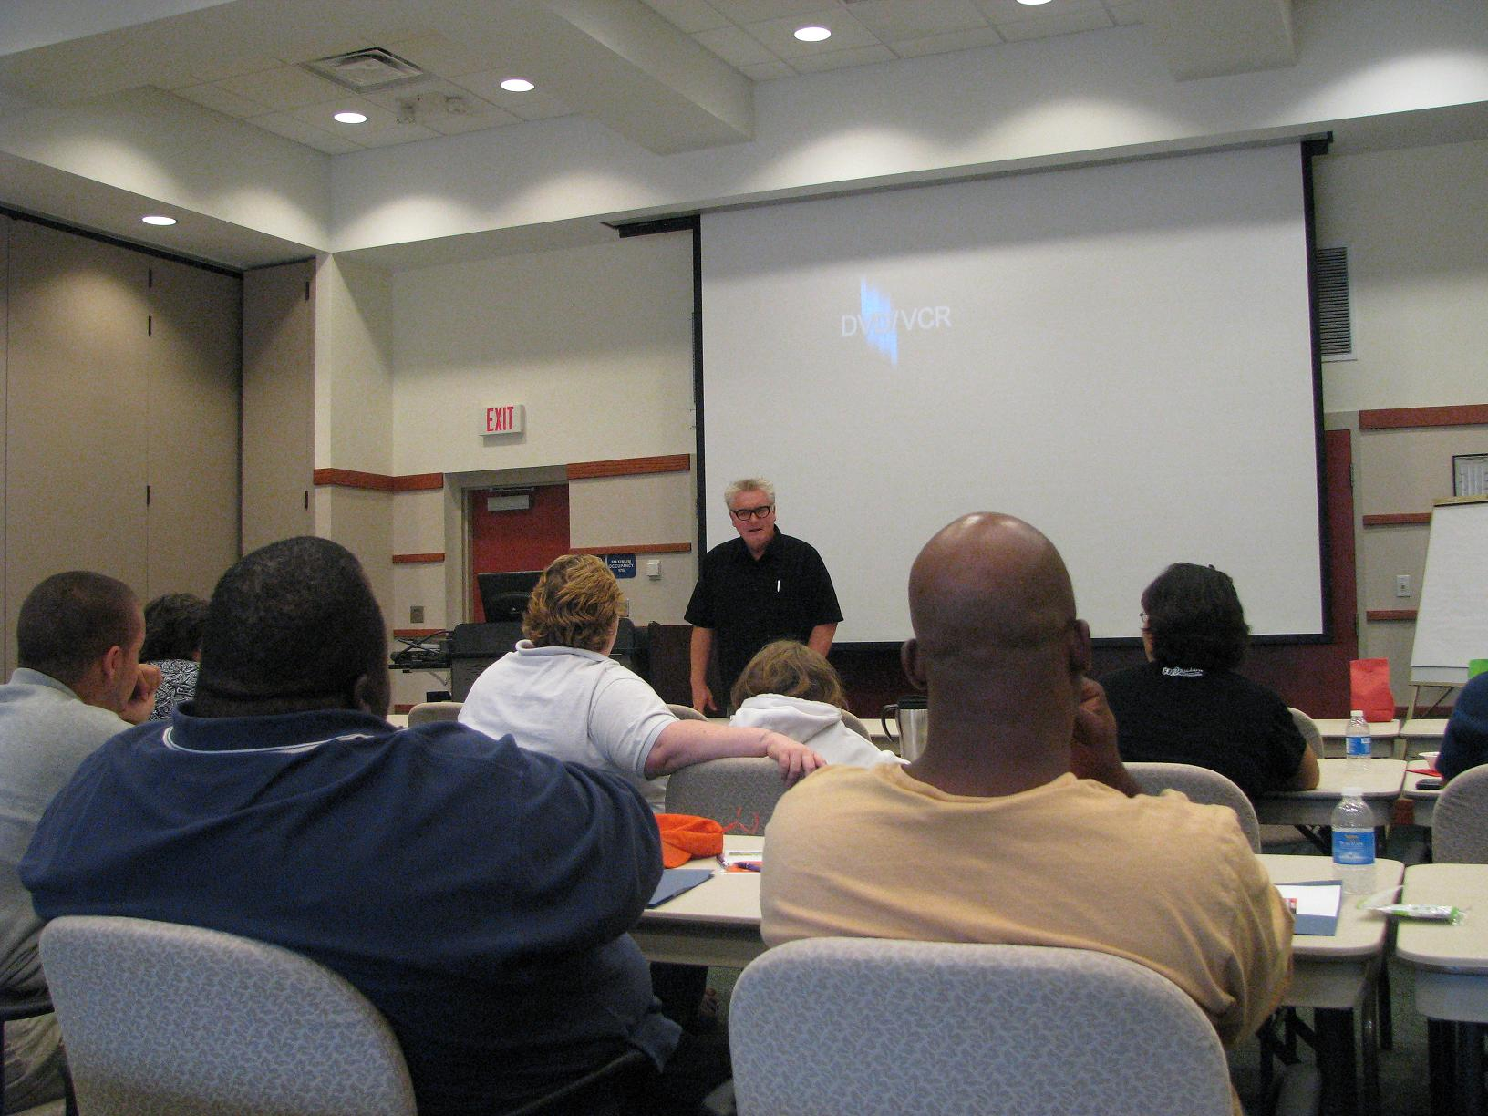

Slide 4
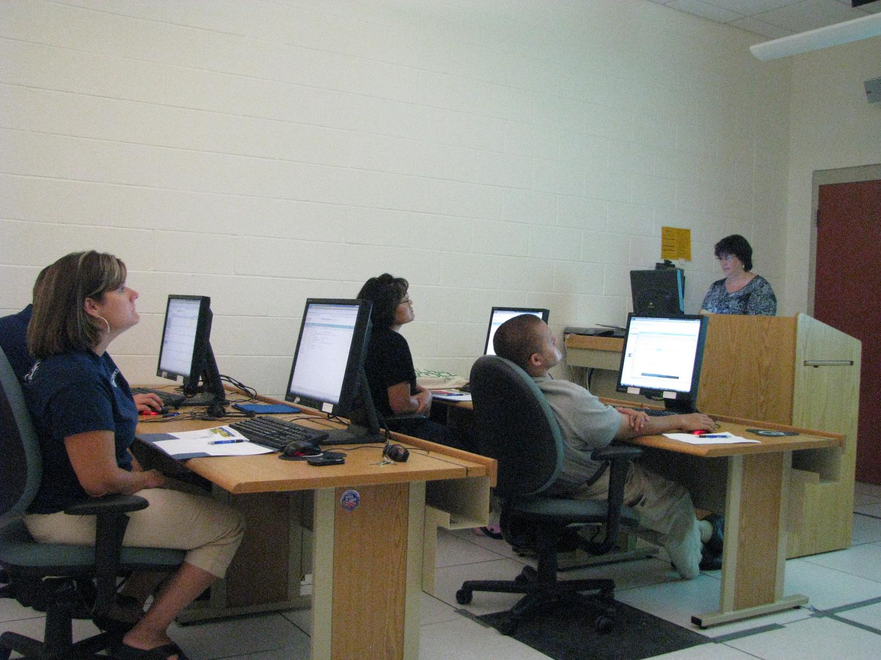

Slide 5
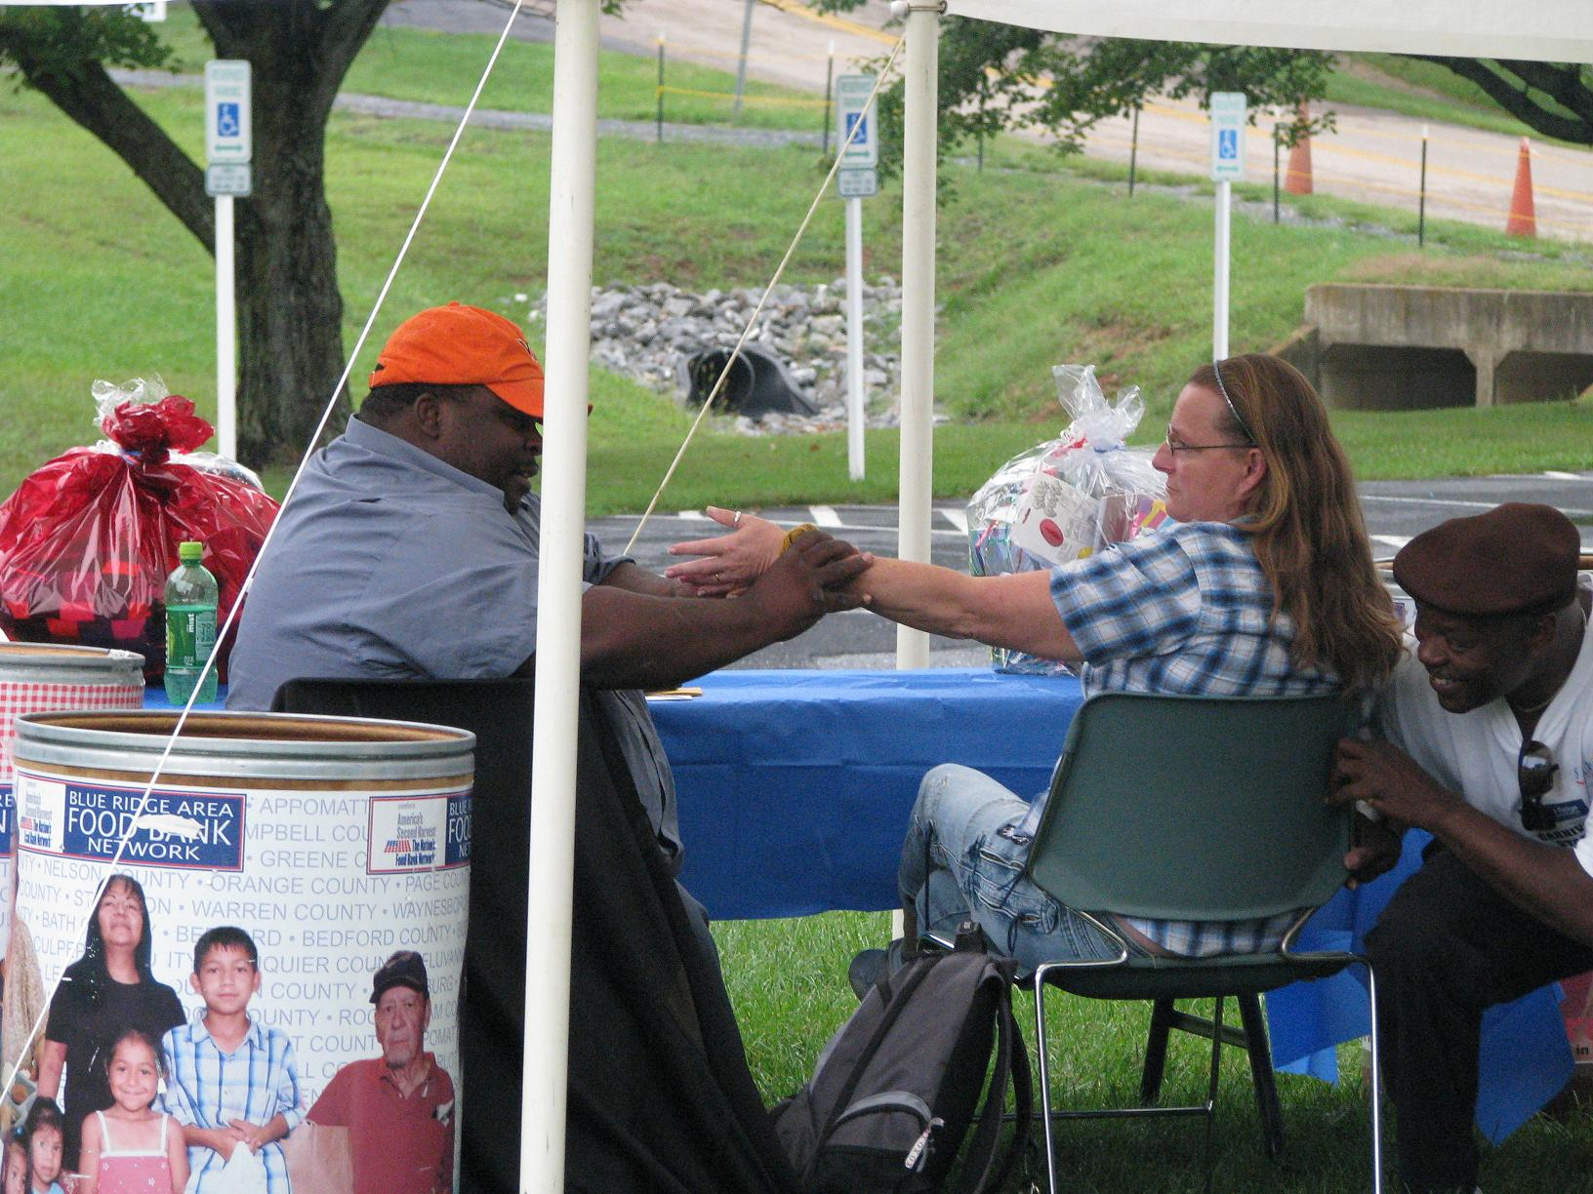
Food Bank Carnival

Slide 6
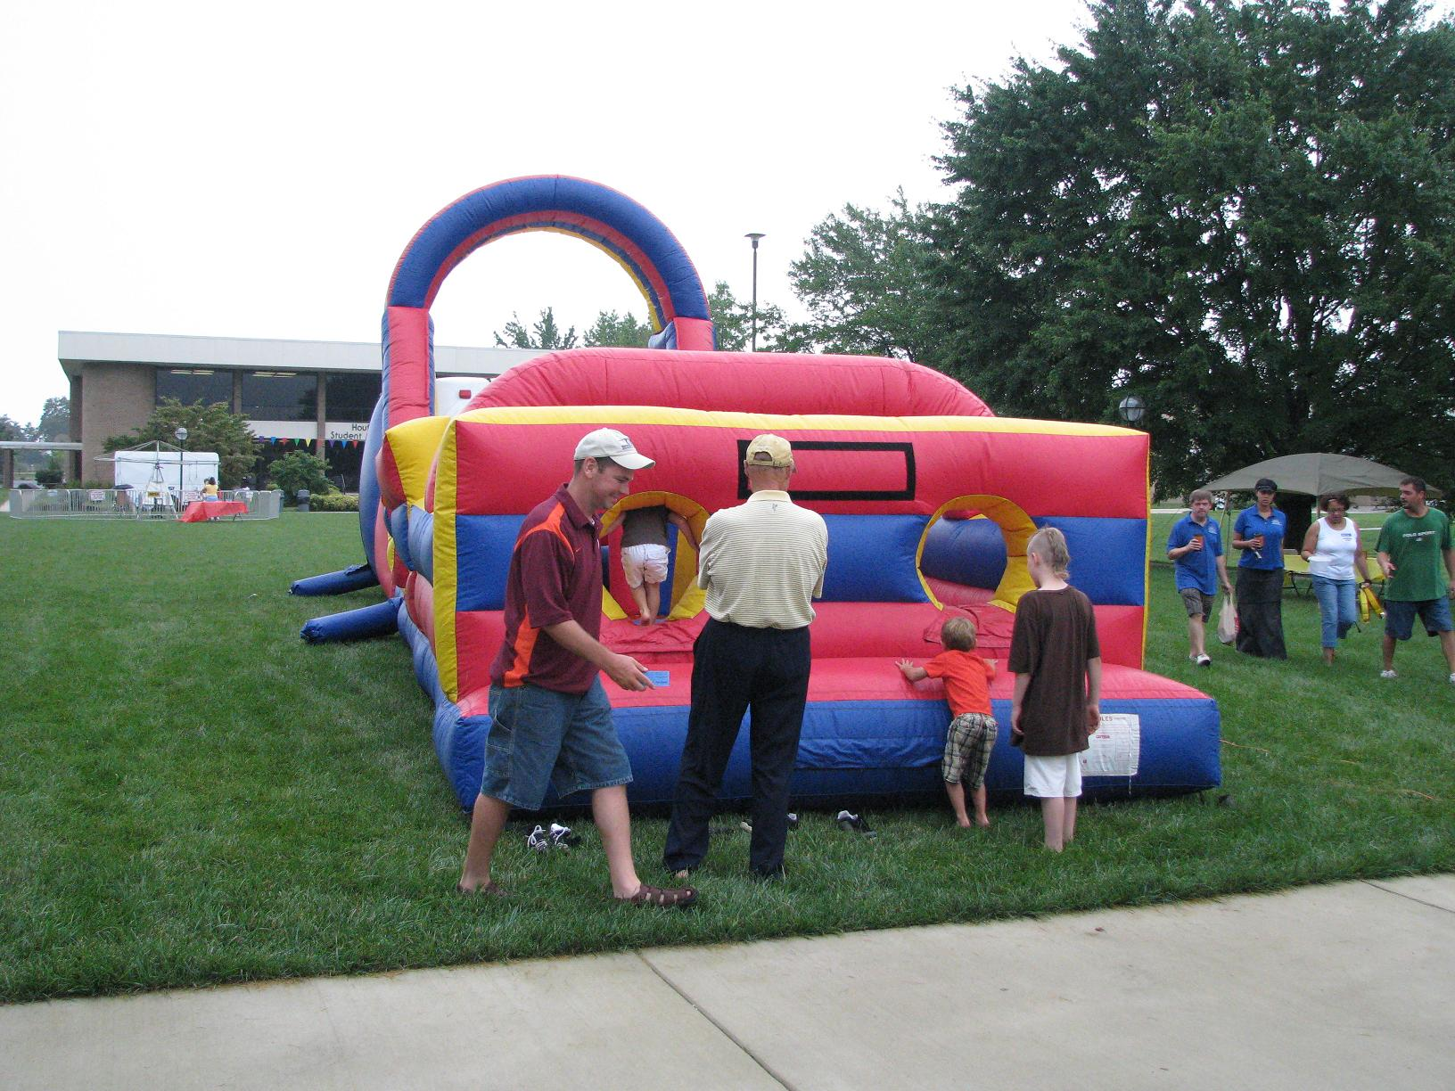

Slide 7
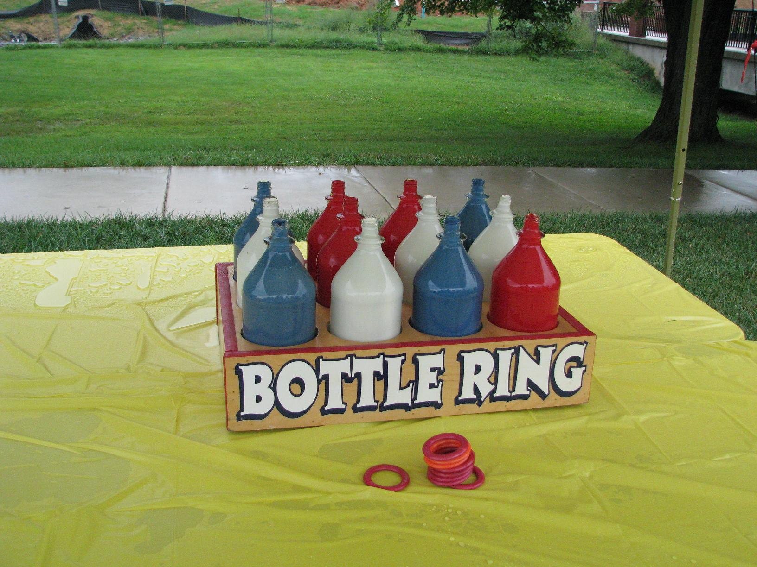

Slide 8
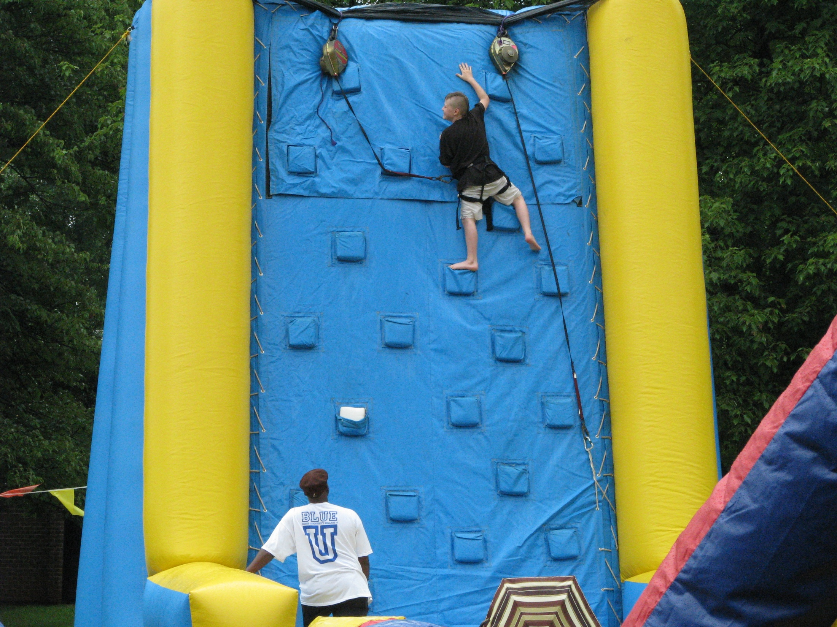

Slide 9
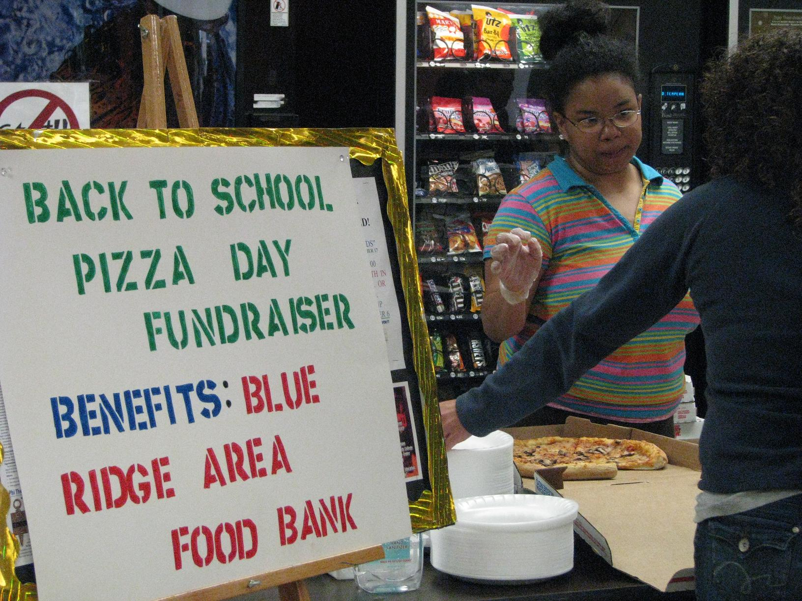
Pizza Day Fundraiser for Food Bank

Slide 10
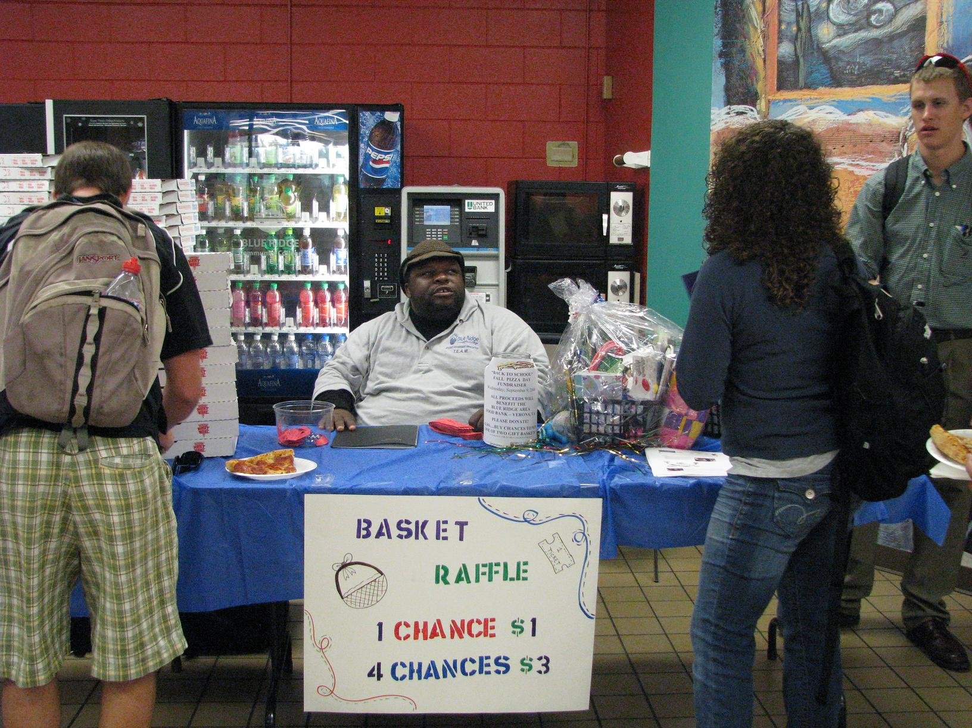

Slide 11
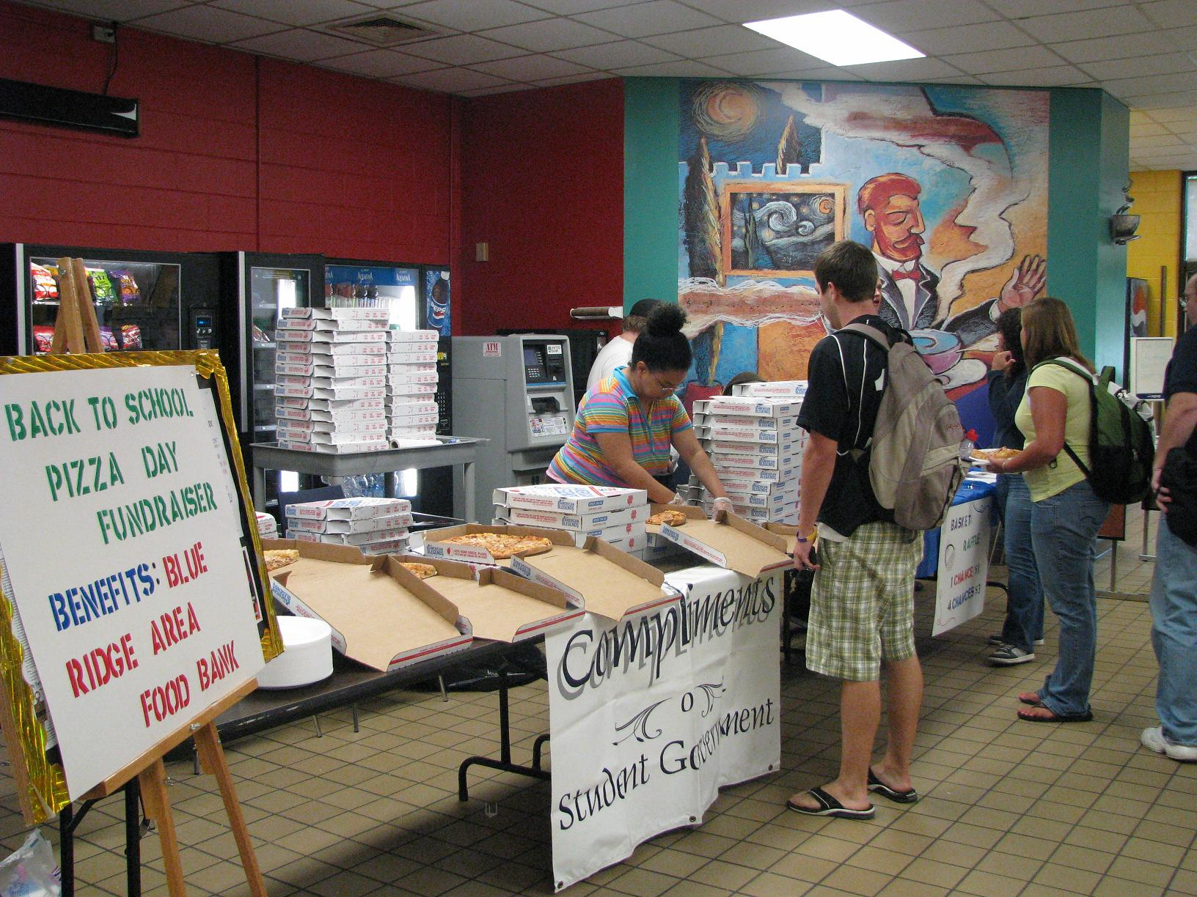

Slide 12
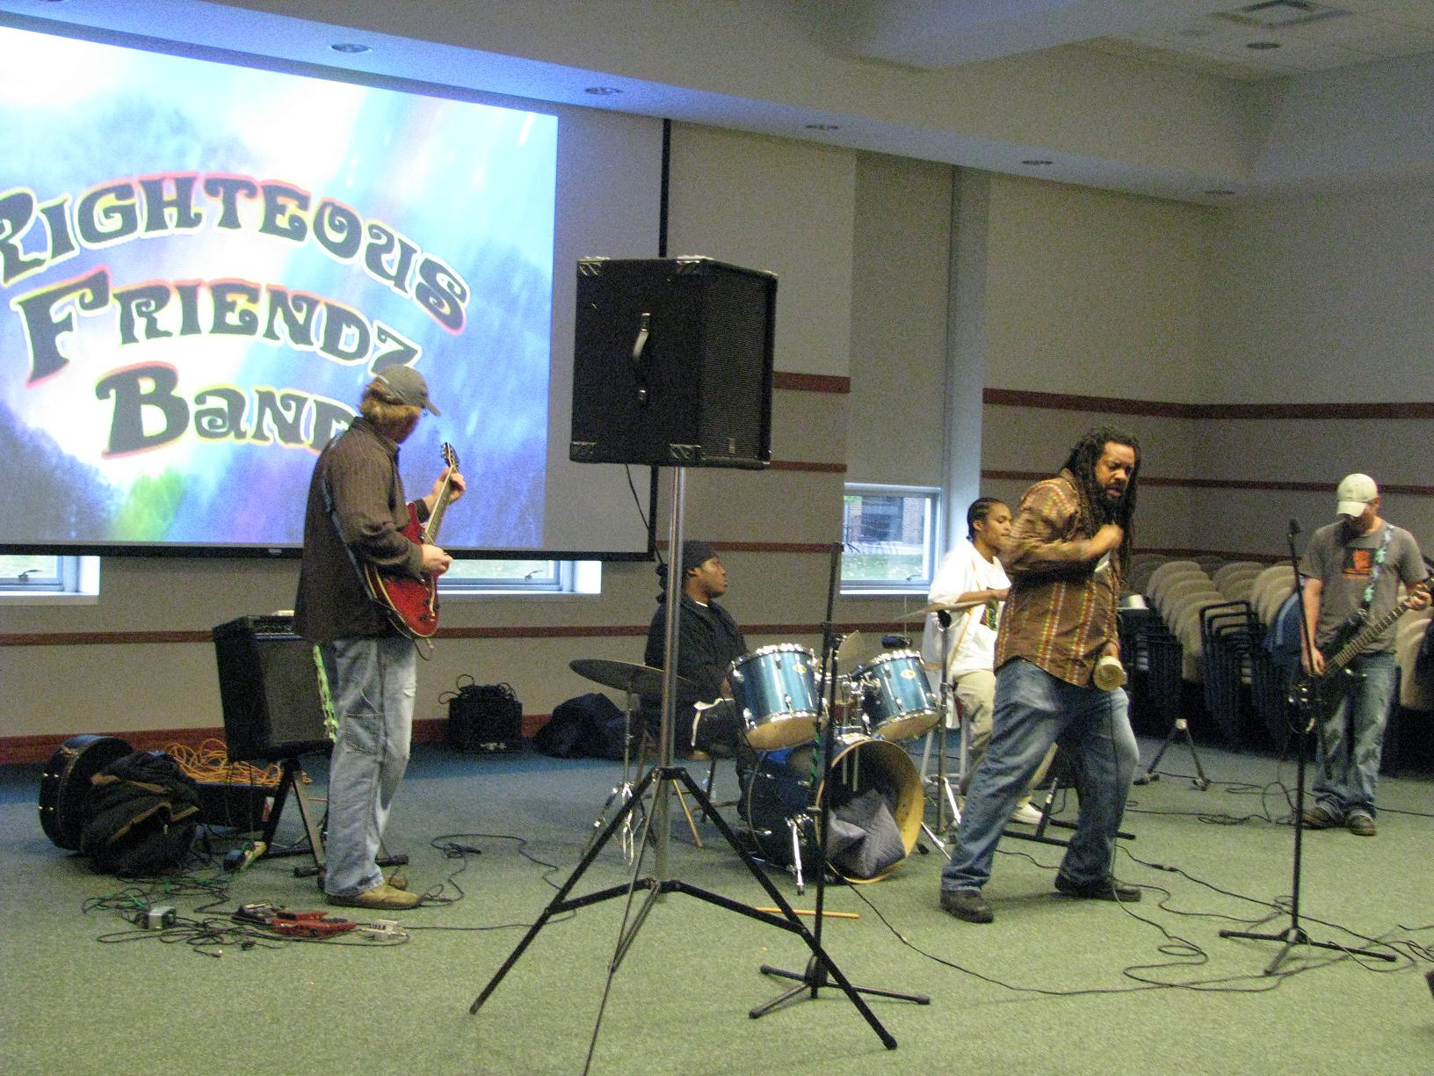
Battle of the Bands Fundraiser

Slide 13
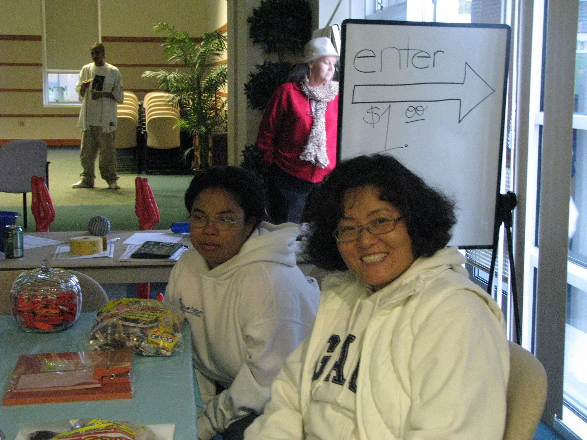

Slide 14
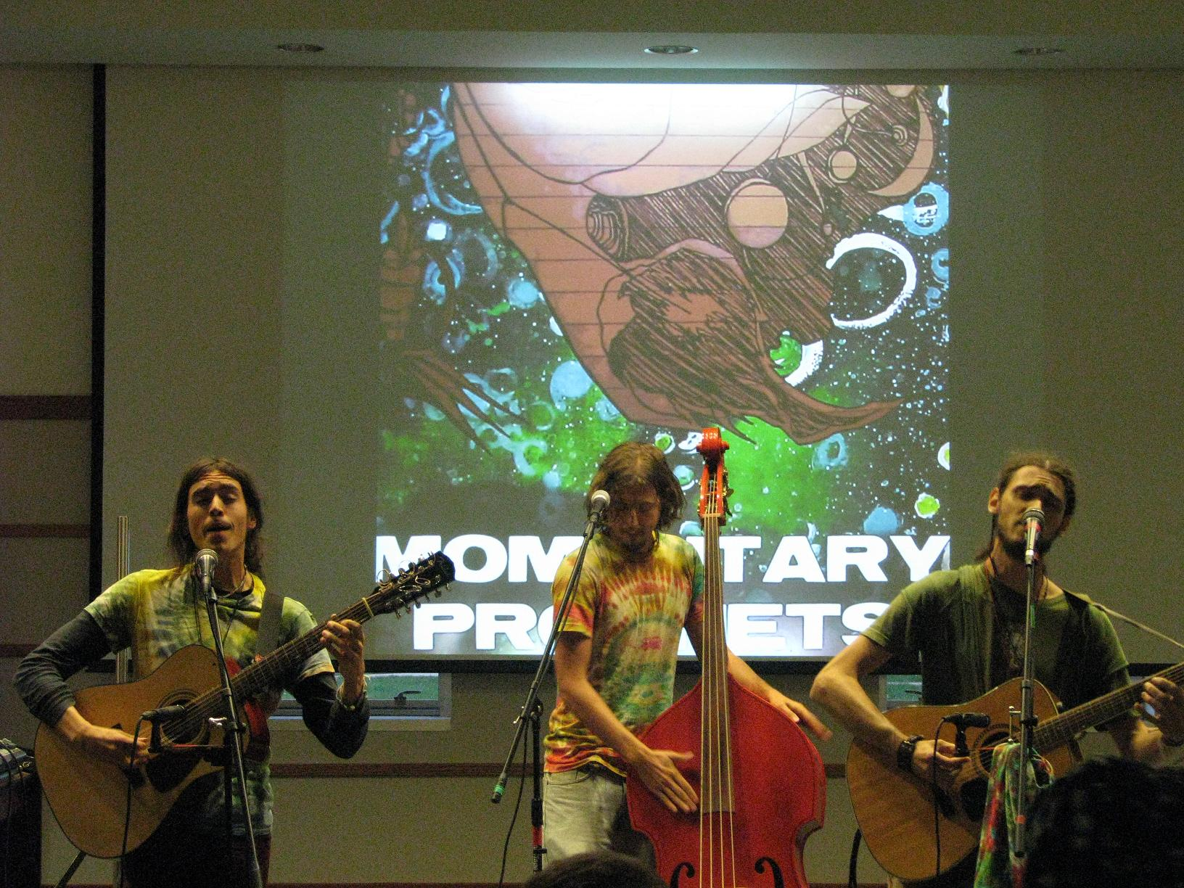

Slide 15
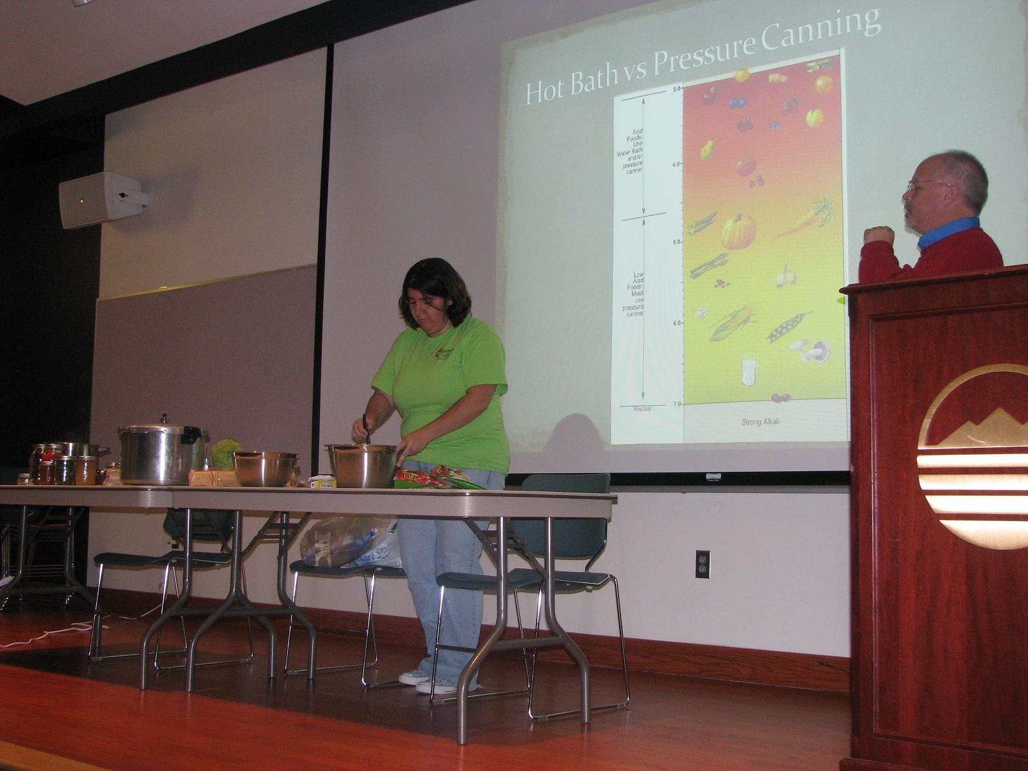
Hunger Symposium Presentation on Canning

Slide 16
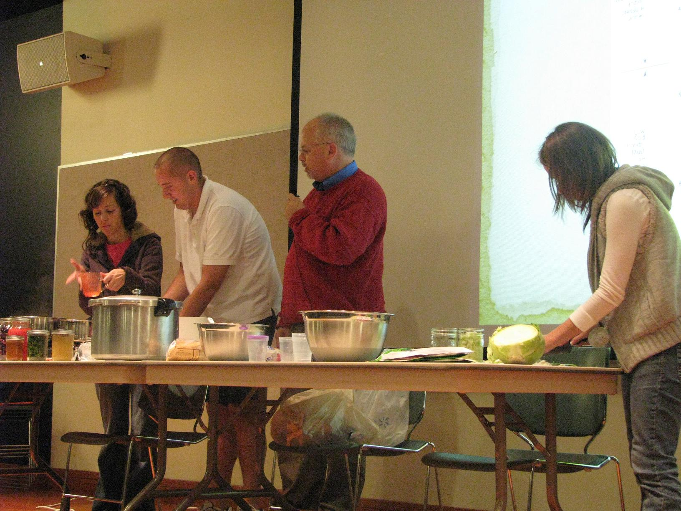

Slide 17
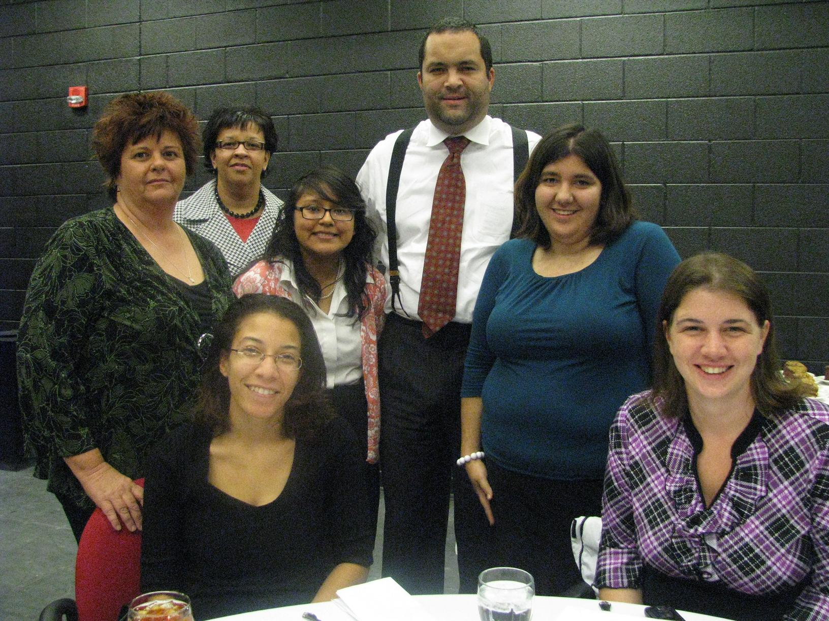
Ben Jealous Event

Slide 18
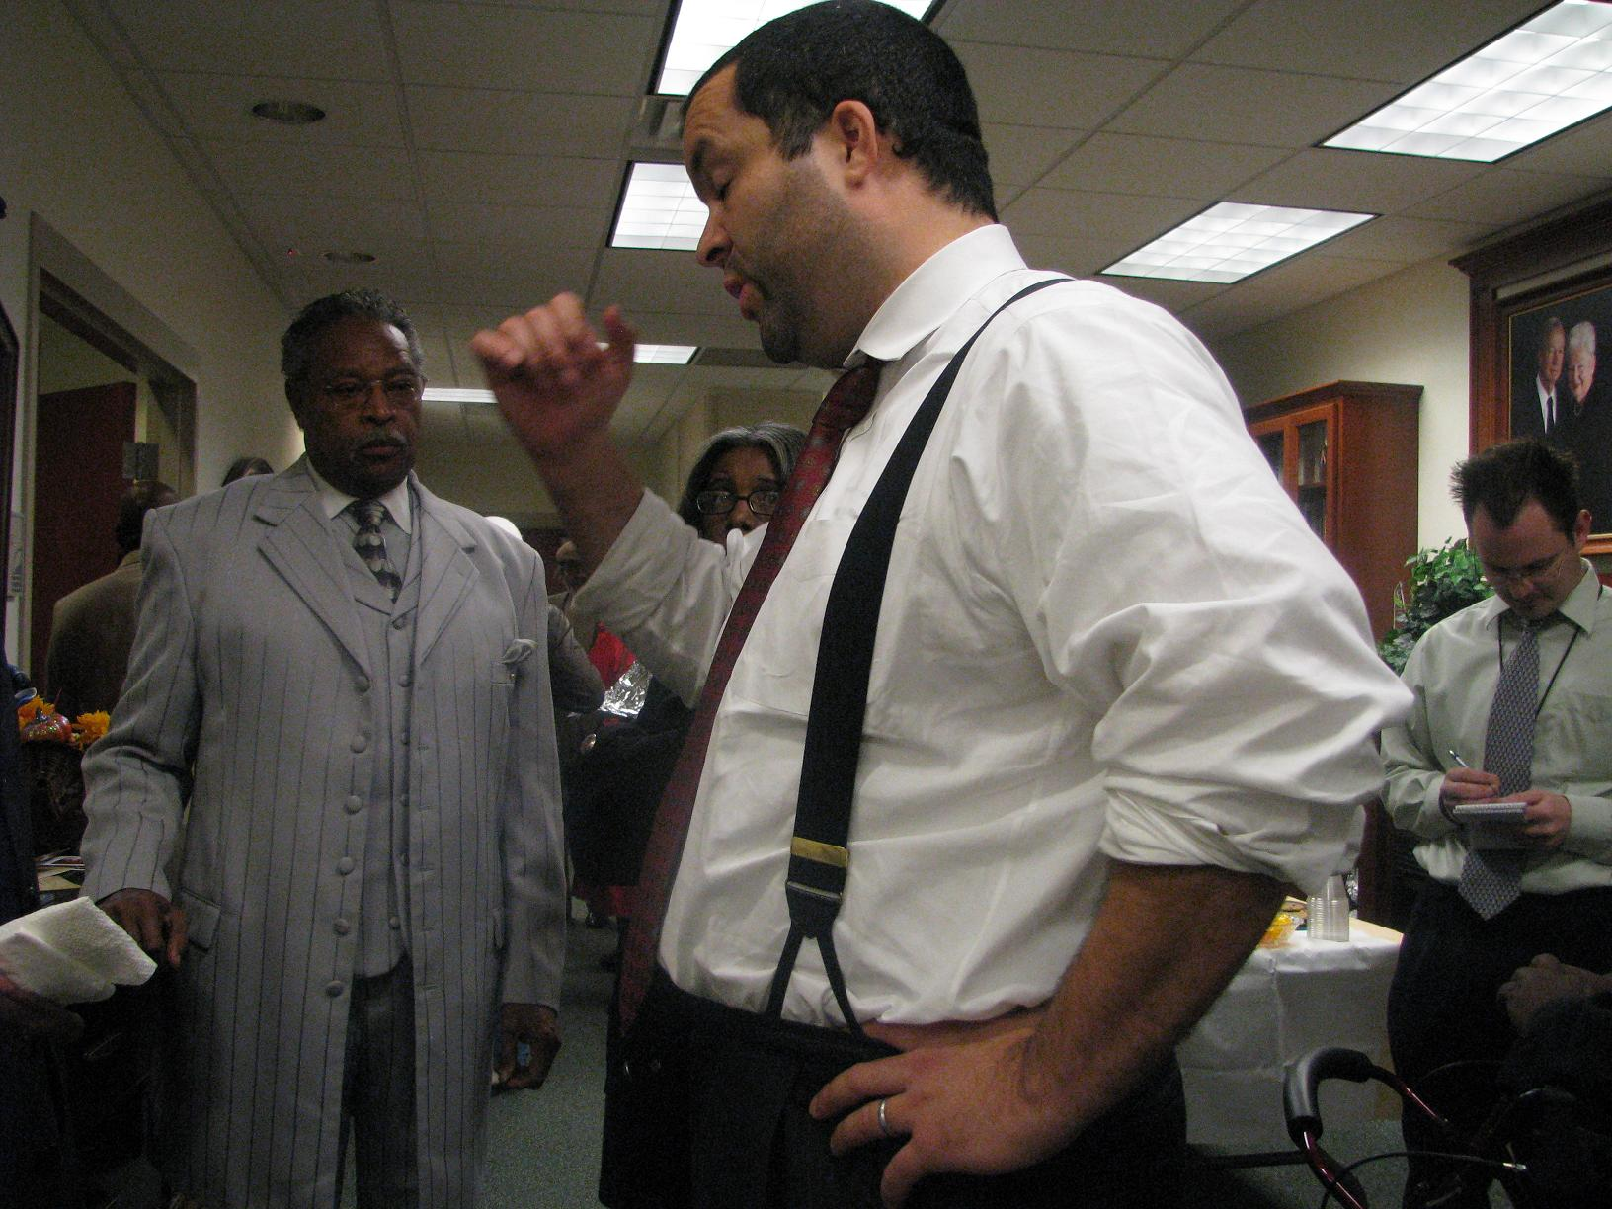

Slide 19
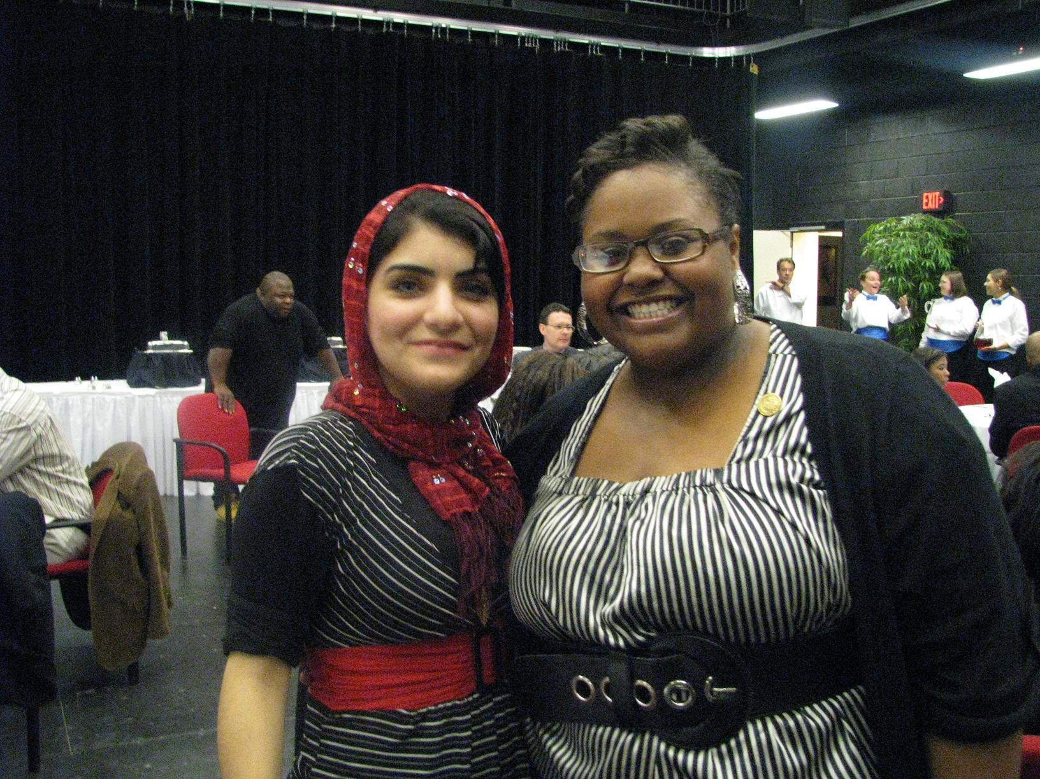

Slide 20
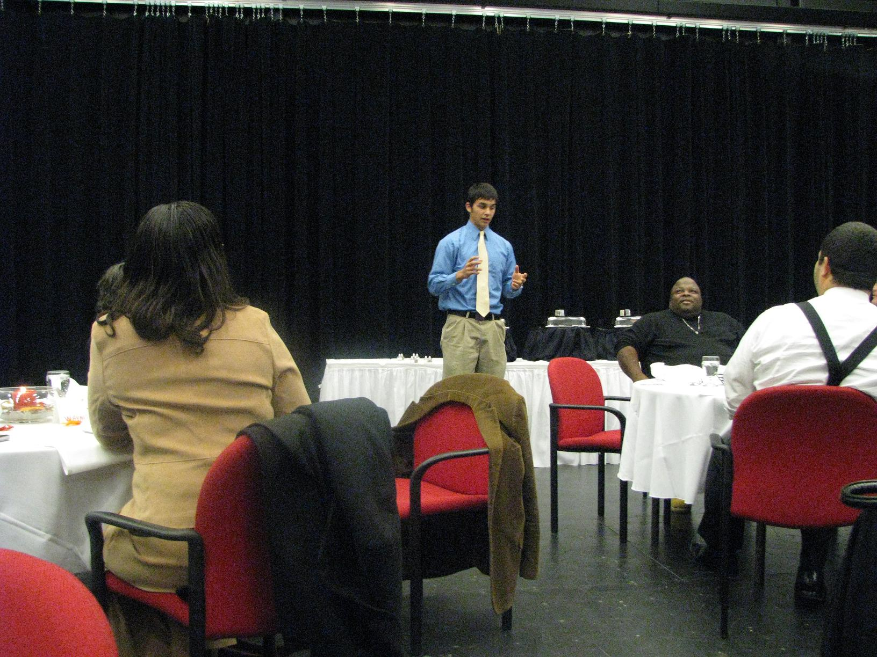

Slide 21
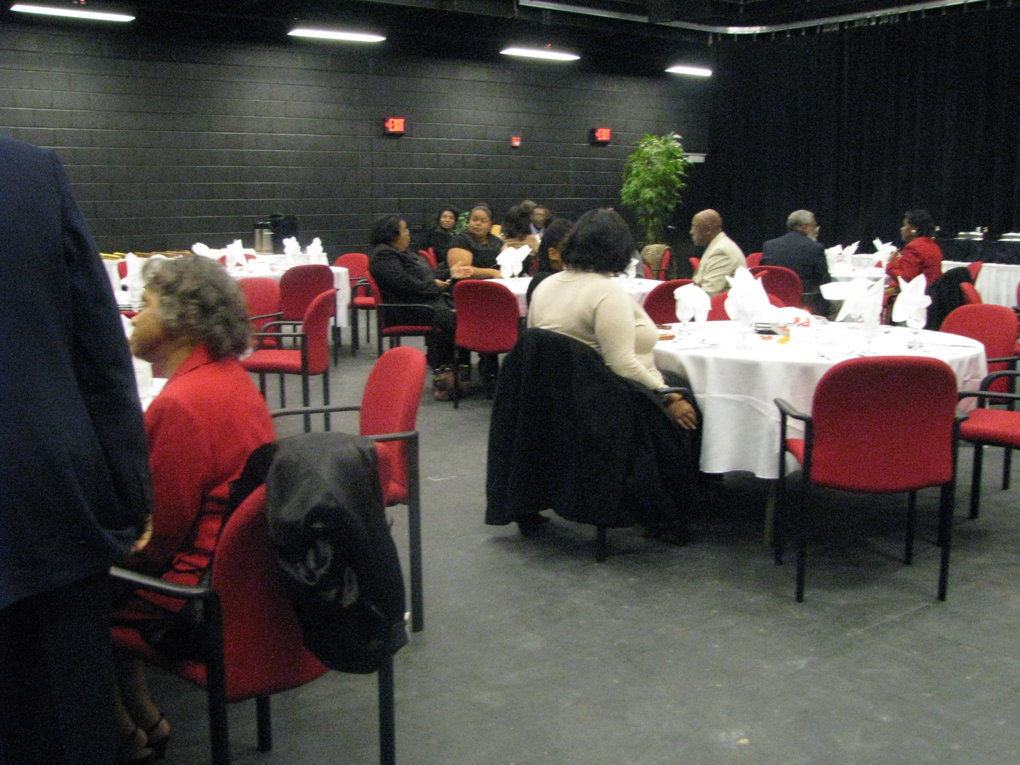

Slide 22
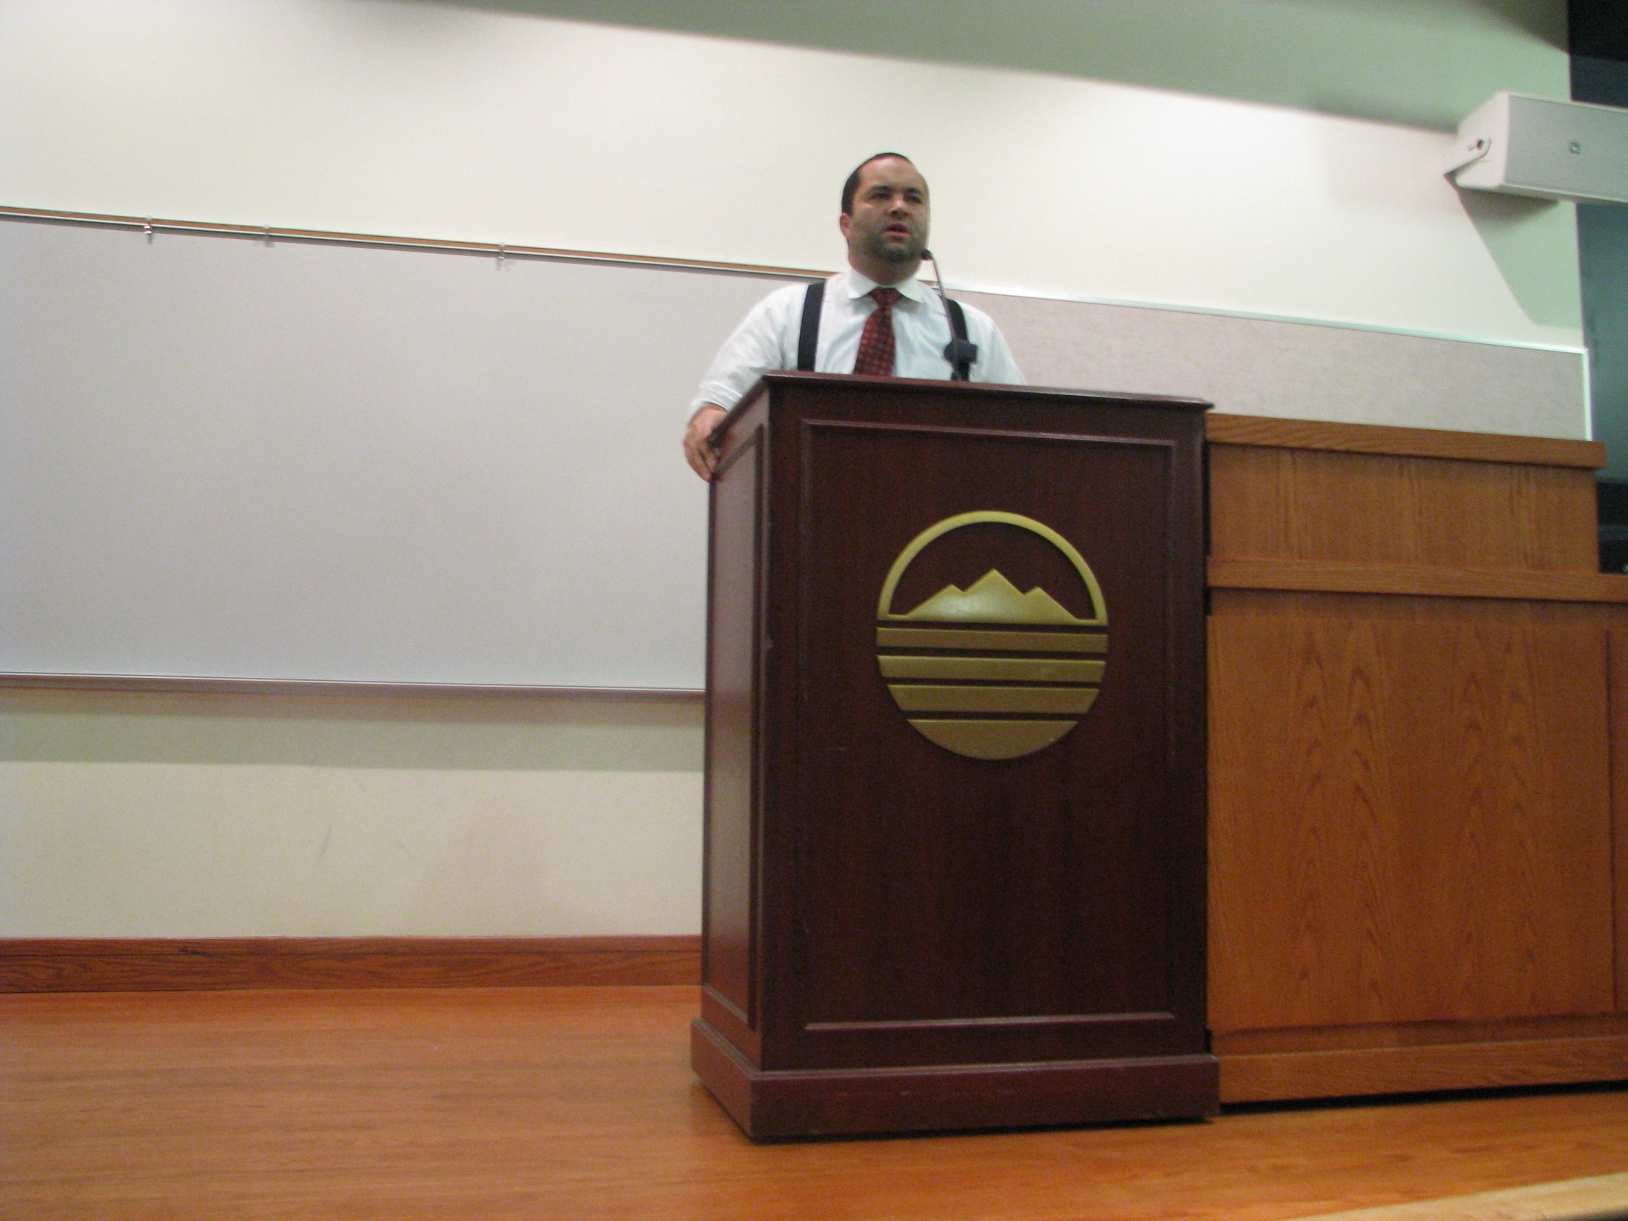

Slide 23
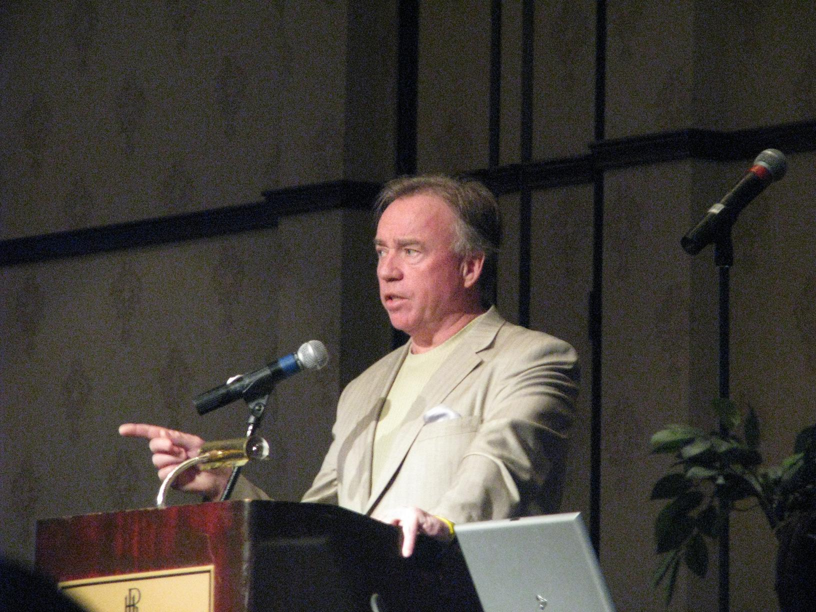
VCCS Student Leadership Conference

Slide 24
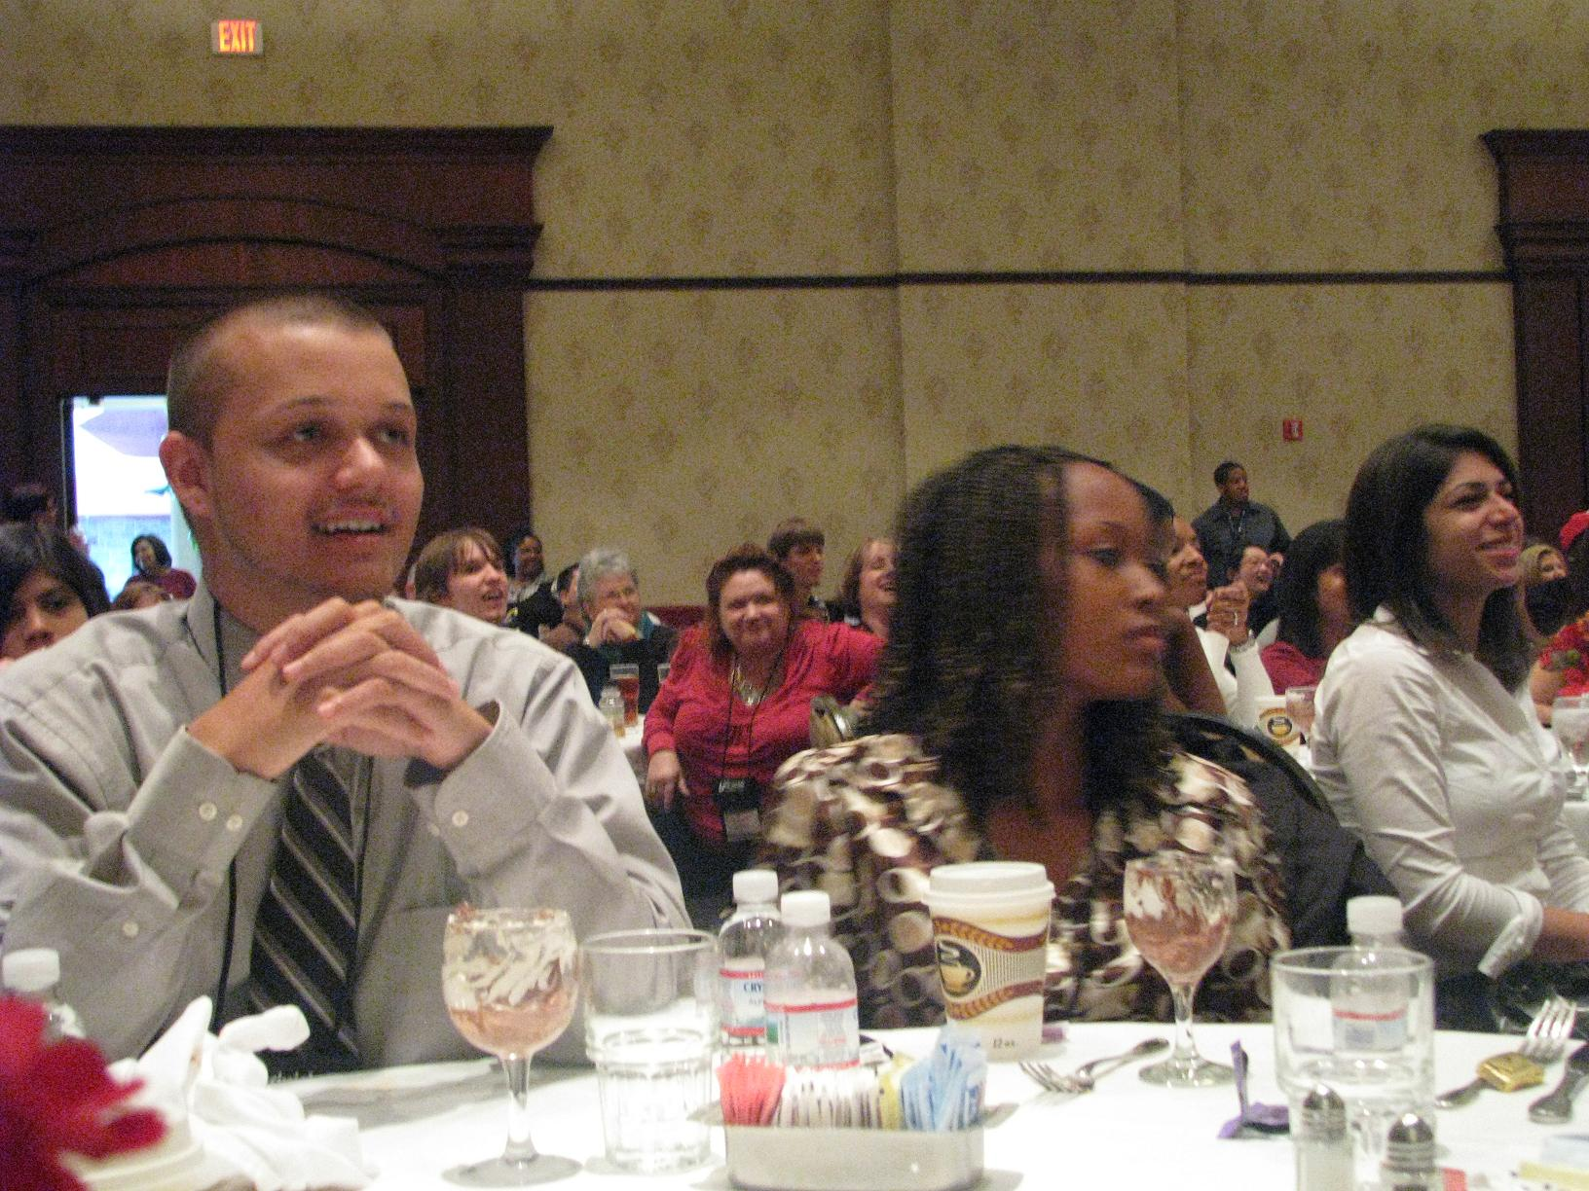

Slide 25
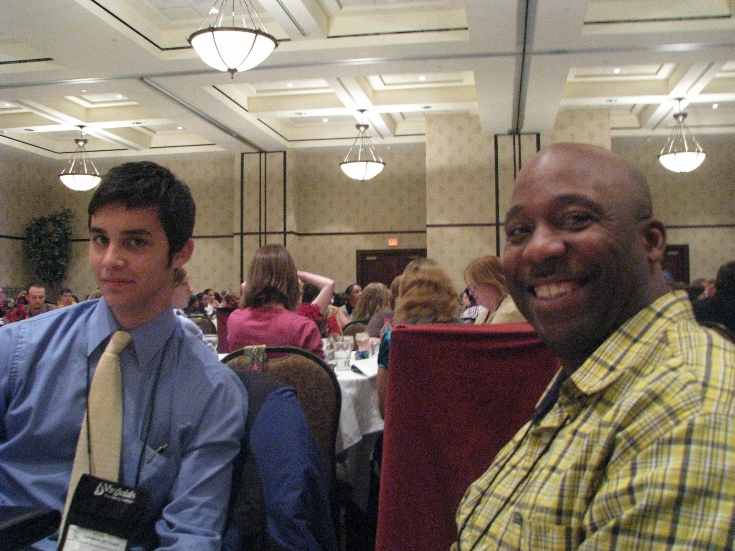

Slide 26
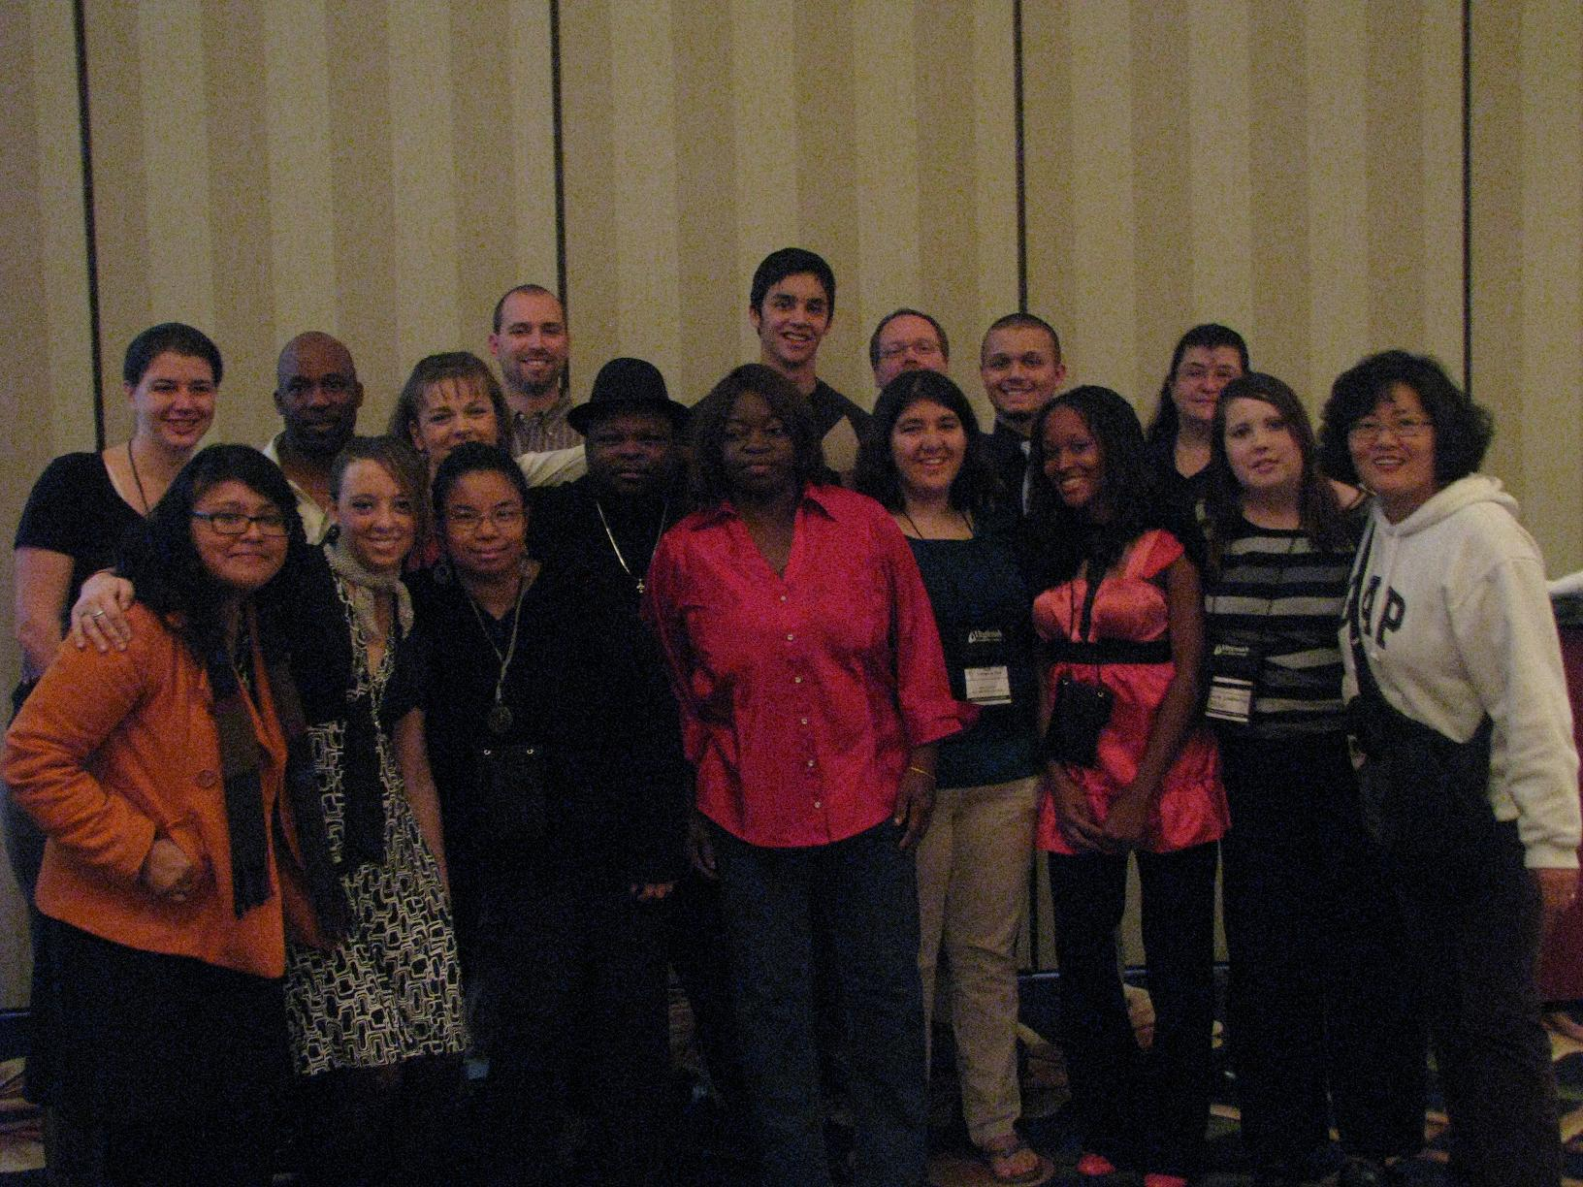

Slide 27
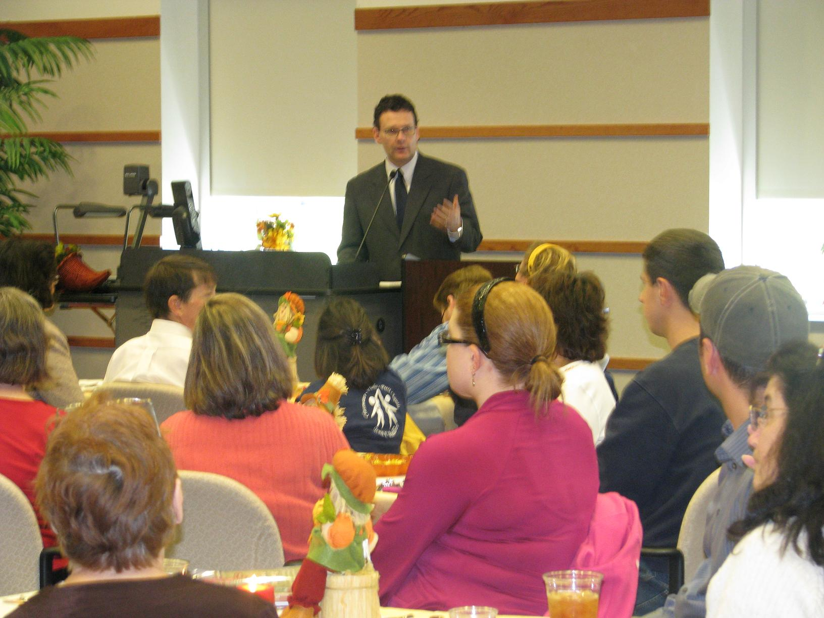
Club Advisors Appreciation Luncheon

Slide 28
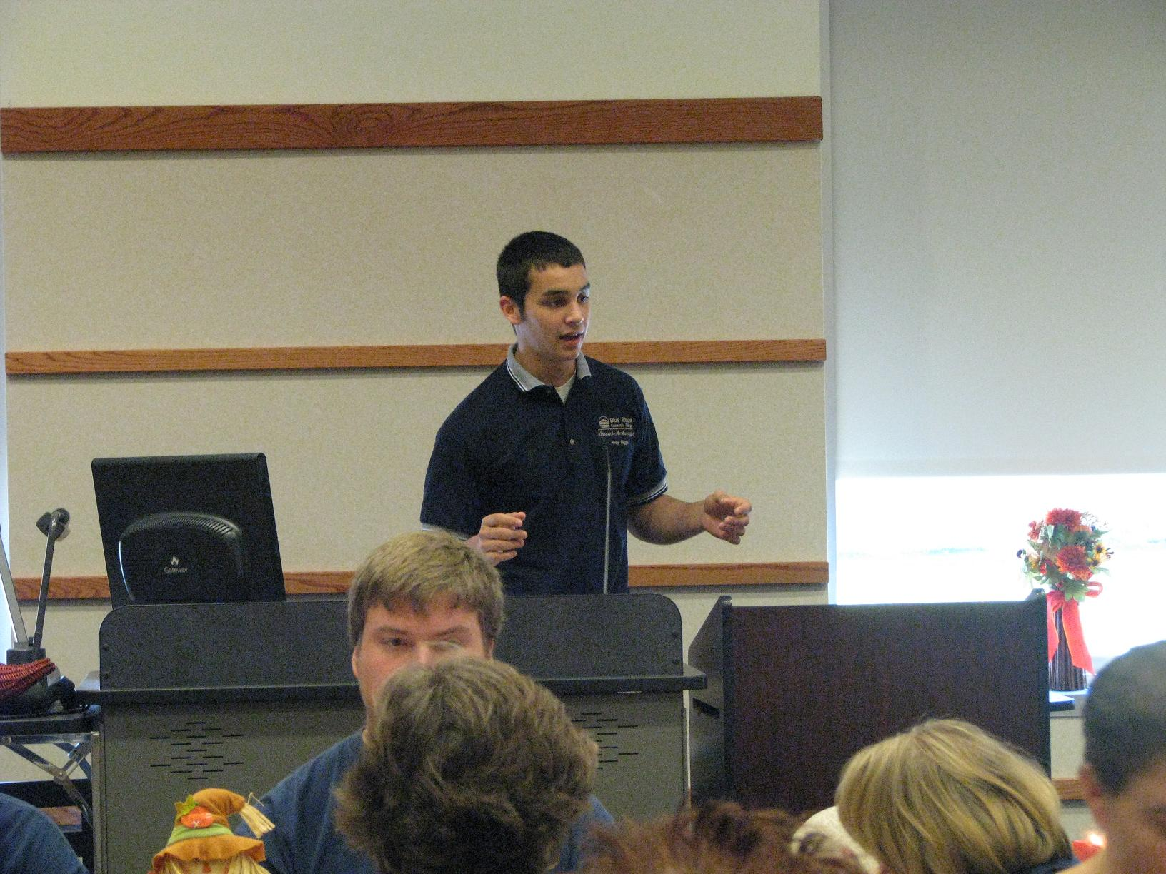

Slide 29
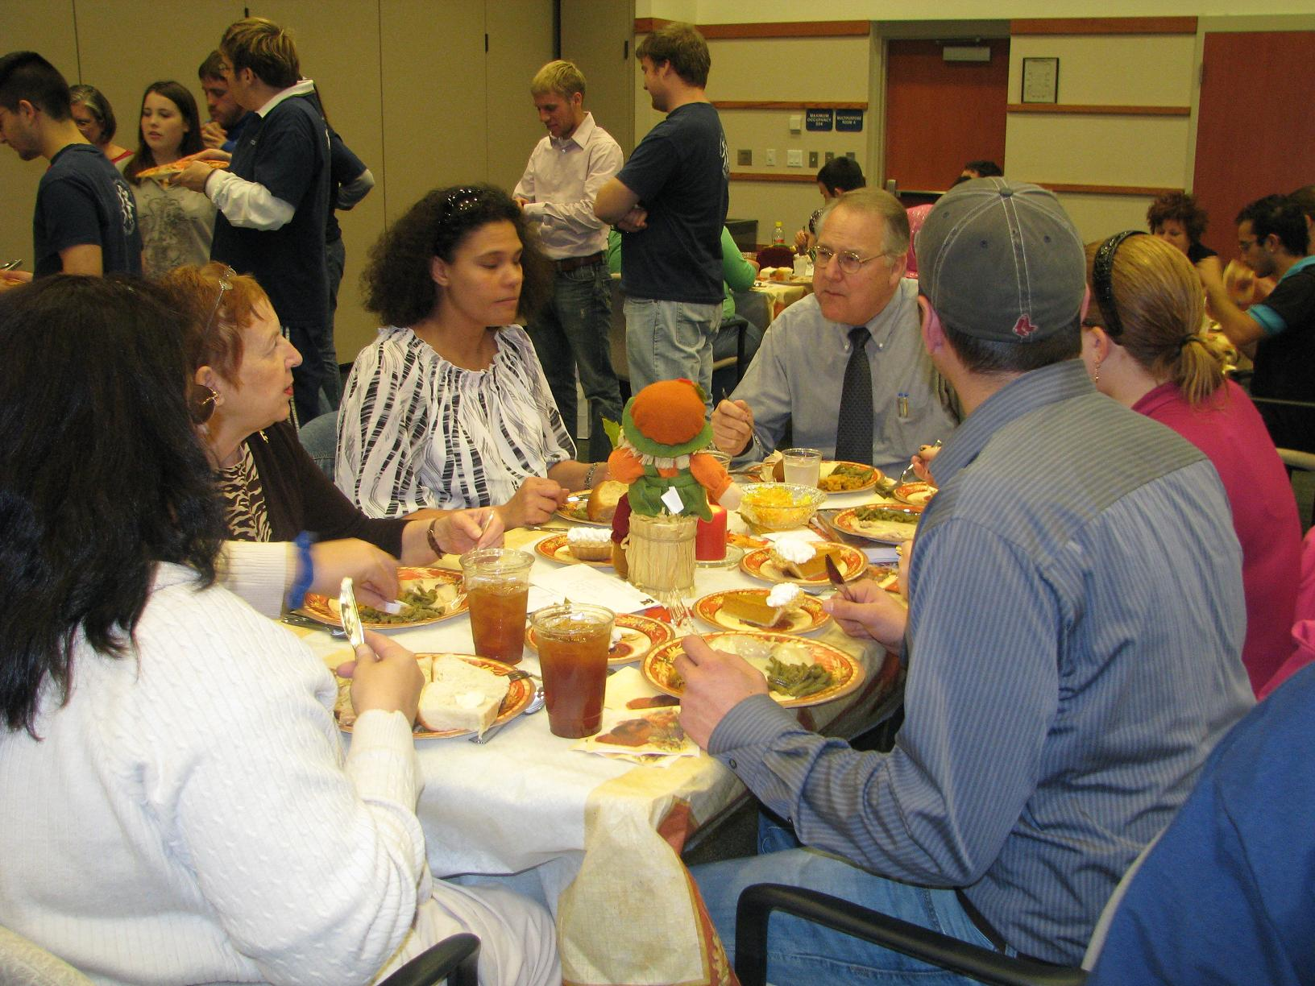

Slide 30
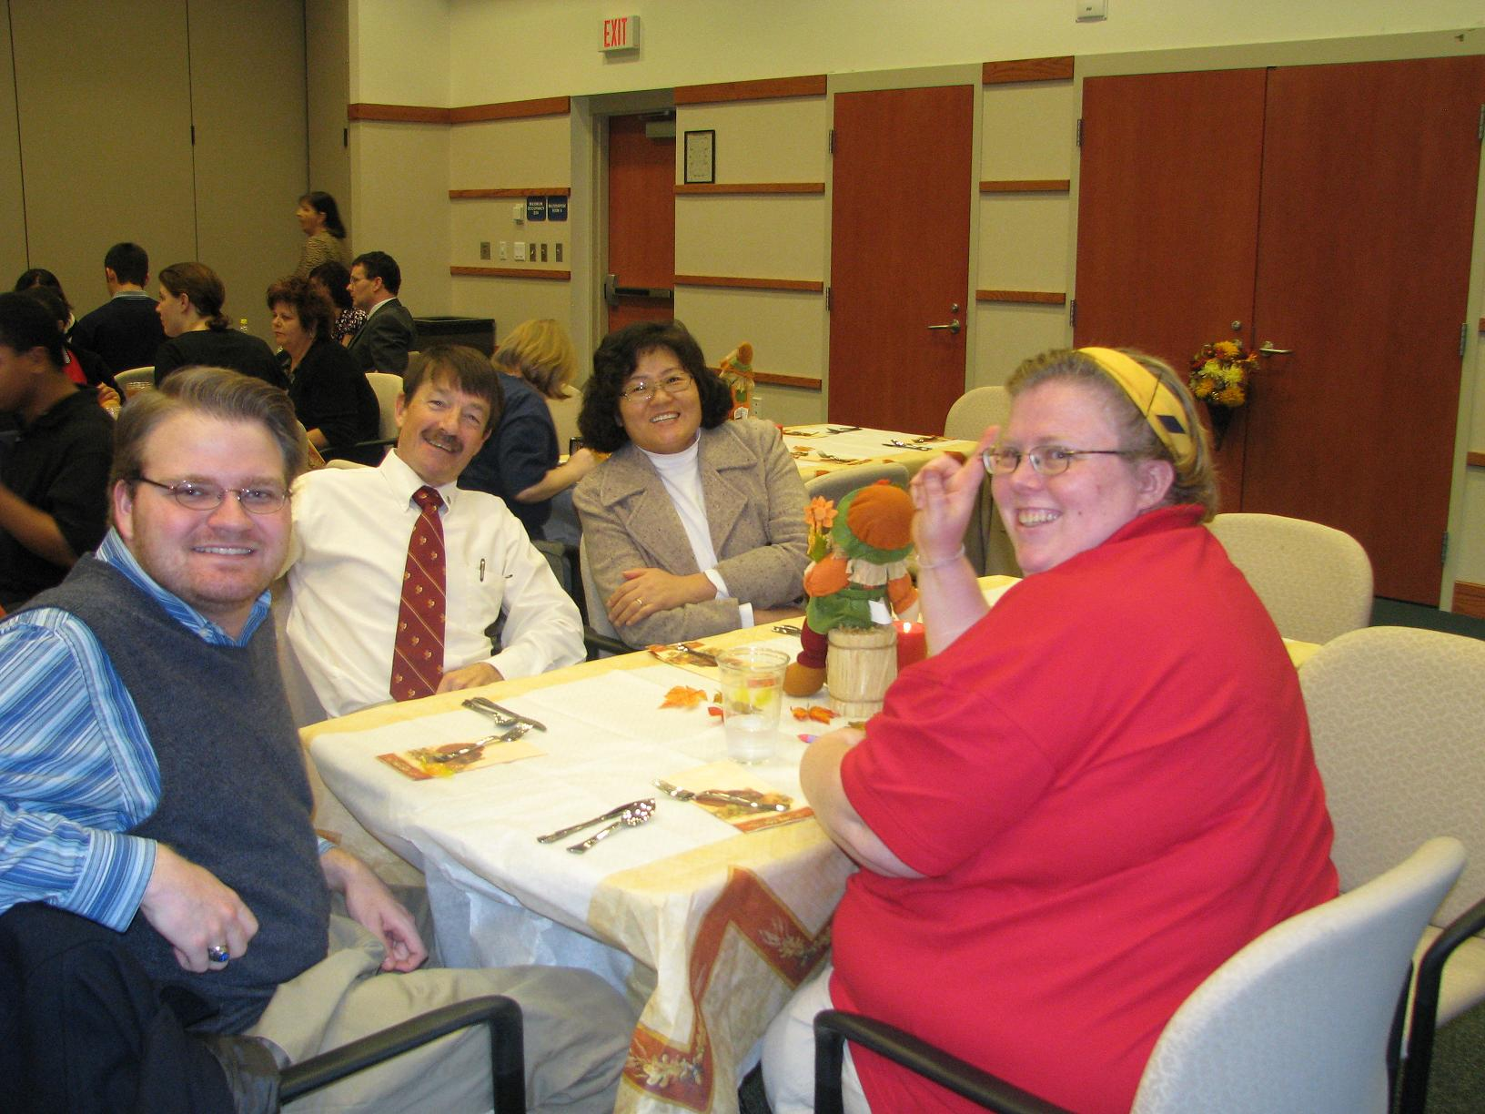

Slide 31
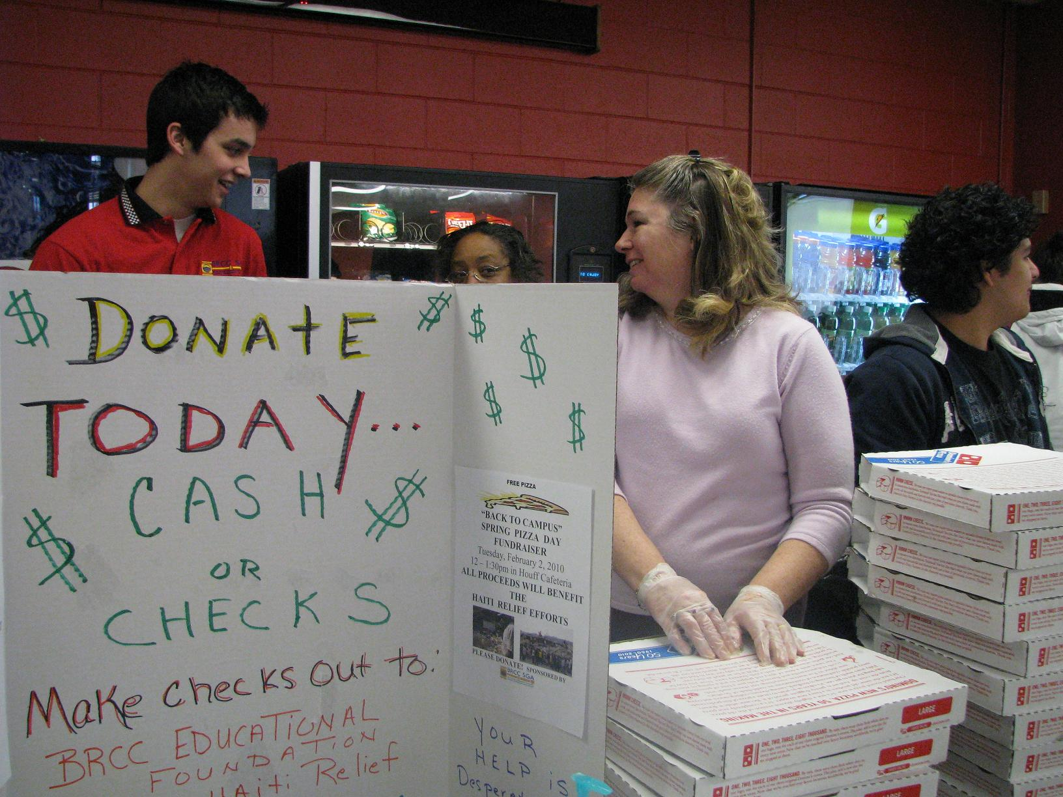
Fundraiser for Haiti Relief Fund

Slide 32
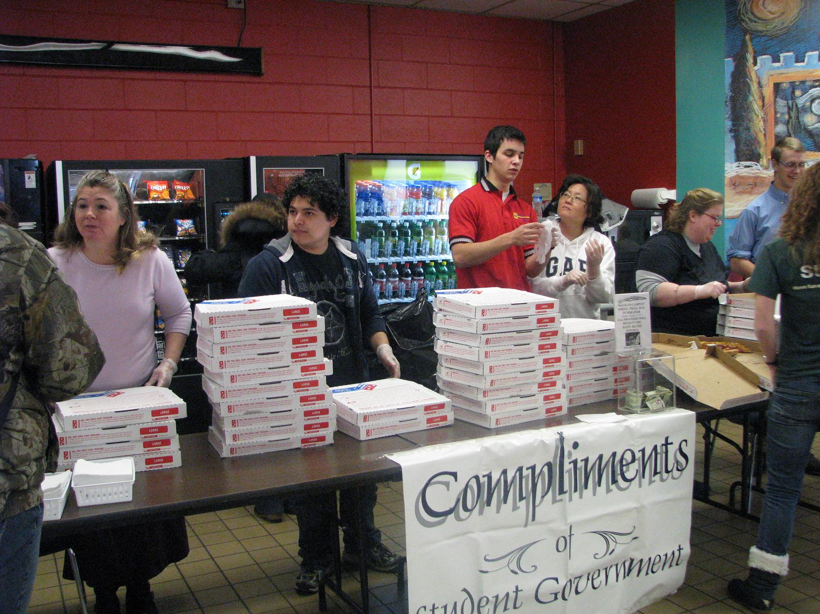

Slide 33
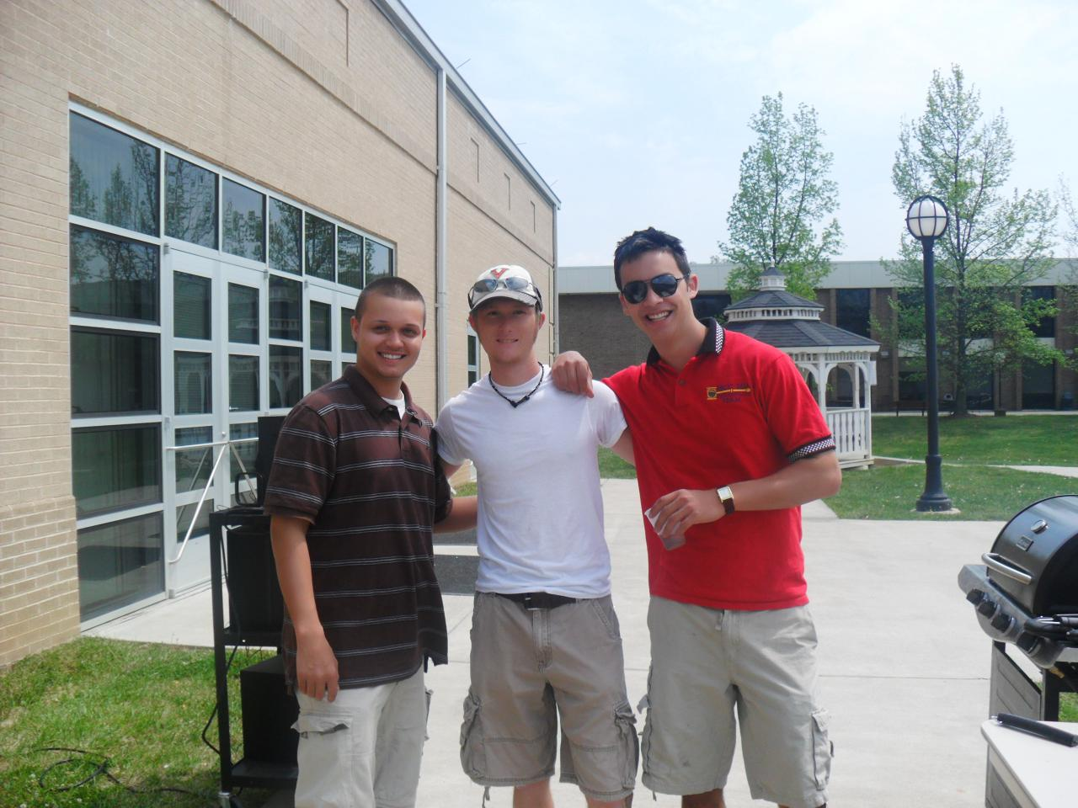

Slide 34
